Slide 1

The Sustainable Materials Management
Webinar Series
Social Media and Environmental Sustainability
Tuesday November 17, 2015/1:30 – 2:45PM ET
Presenter:
Julie Lando, President of GR!T Marketing Group

Slide 2
Goals for Today
Why Social Media?
Which channels are best?
Why is social media important to have as a component of your business?
Answer your questions

Slide 3
Introduction to social media
What is social media?
What is social media?
Social media is an interactive form of communication that focuses on two-way communication.
Allows individuals the ability to not only share information, but also engage in conversations with one another.
Create content to share on social media that sparks engagement and two-way communication.
Can be in the form of blogs, social networks, micro-blogs, photo sharing and video sharing.

Slide 4
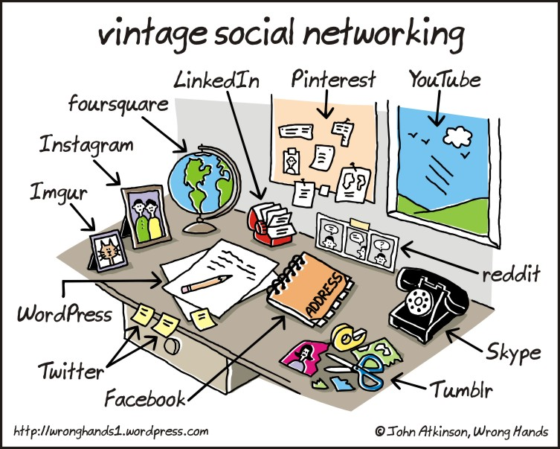

Slide 5

Meet Audiences Where They Are

Slide 6
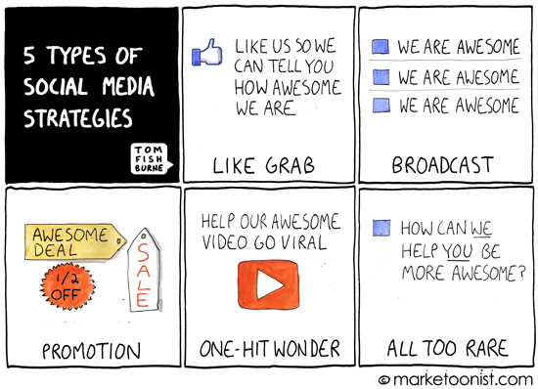

Slide 7
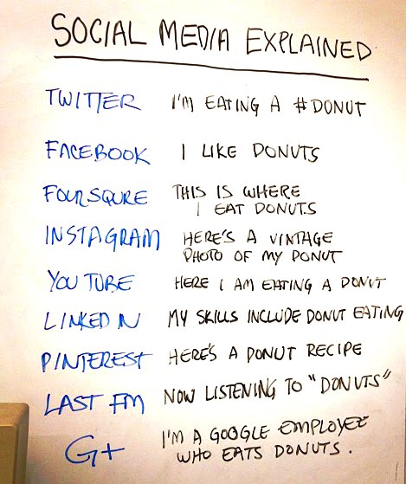

Slide 8
Build Brand Loyalty
53% of Americans who follow a brand on social are more loyal to those brands.
According to 2014 Convince & Convert Study

Slide 9
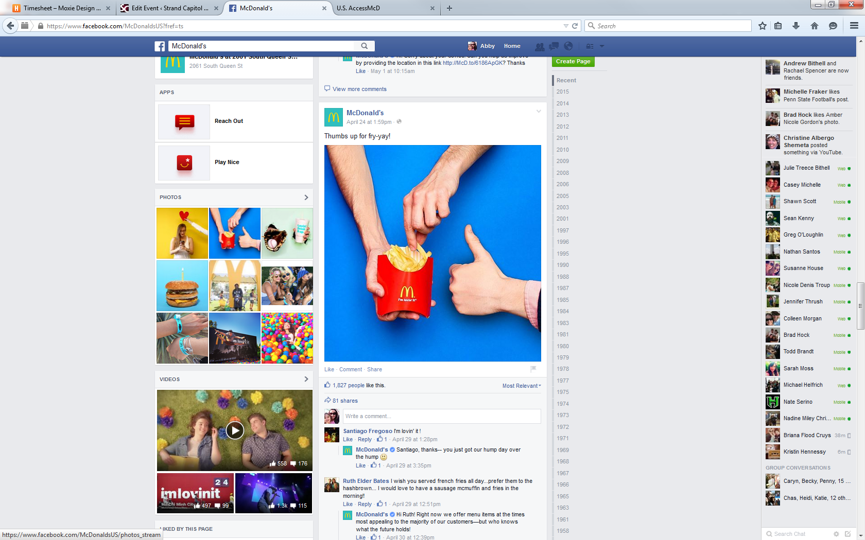
Address Detractors/
Activate Advocates

Slide 10
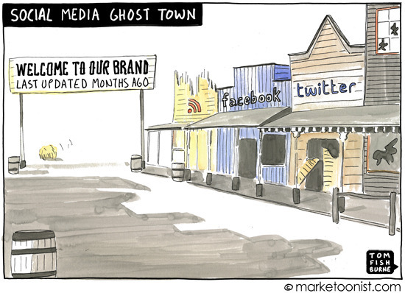
Commit to the Conversations

Slide 11
Which Channels Are Best?
Where is Your Audience?
Age, Demographics, Activities on Channels
What are Your Goals?
SEO, Engagement, Customer Service,
Awareness, Networking , Sales
What Are Your Resources?
Content Creation, Monitoring & Engagement

Slide 12

Which Channels Are Best?
52% of online adults use multiple social media sites.
Facebook acts as “home base” — it remains the most popular site for those who only use one, and has significant overlap with other platforms.
According to 2014 Pew Research Report

Slide 13
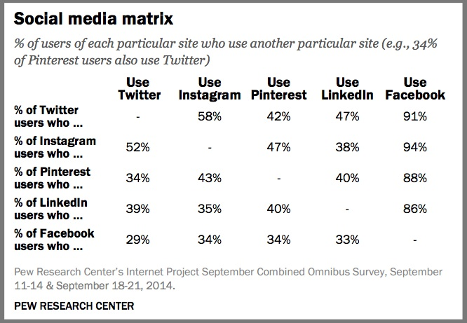

Slide 14
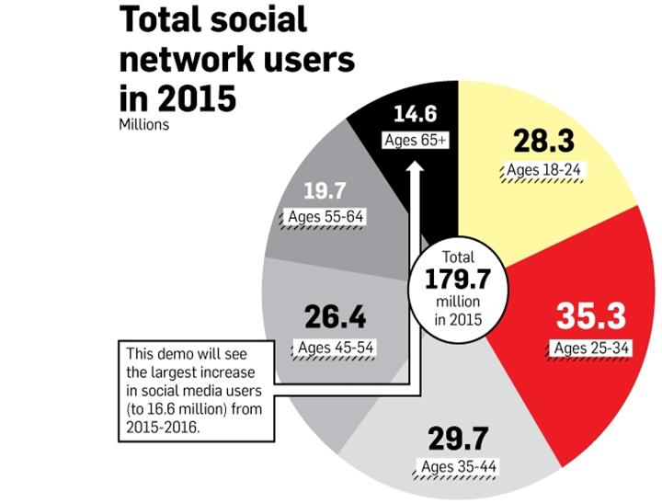
Which Channels Are Best?

Slide 15
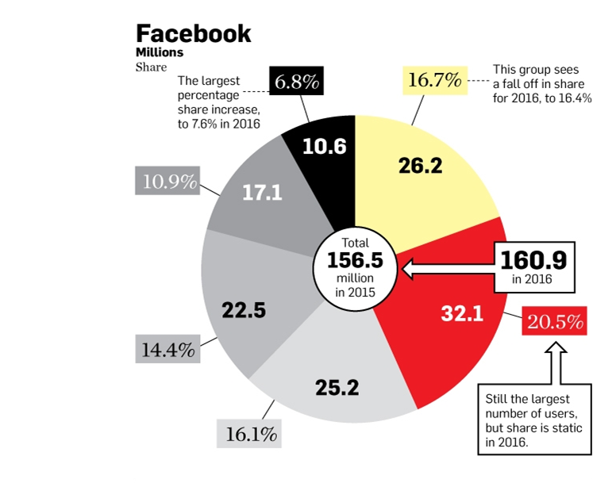
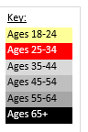
Which Channels Are Best?

Slide 16

Facebook
71% of internet users are on Facebook
Remained fairly flat in 2014 except with 65+
70% of users engage daily (up from 63% in 2013)
According to 2014 Pew Research Report

Slide 17


Introduction to Facebook
What is Facebook and why use it?
Facebook is a social networking site that allows you to connect and share information and content with others
- Specifically with your current and potential customers
Facebook allows you to build relationships your consumers
- This is the most important reason to be active as a business on Facebook
- Your customers are using it and it provides you with an opportunity to connect with your customers and build a trusting relationship
Facebook allows you to engage your customers and influence your prospects
- When you engage with your customers by providing useful content, they become your brand ambassadors by sharing your content with their friends, influencing them to ‘like’ your page and/or become aware of your business and services

Slide 18
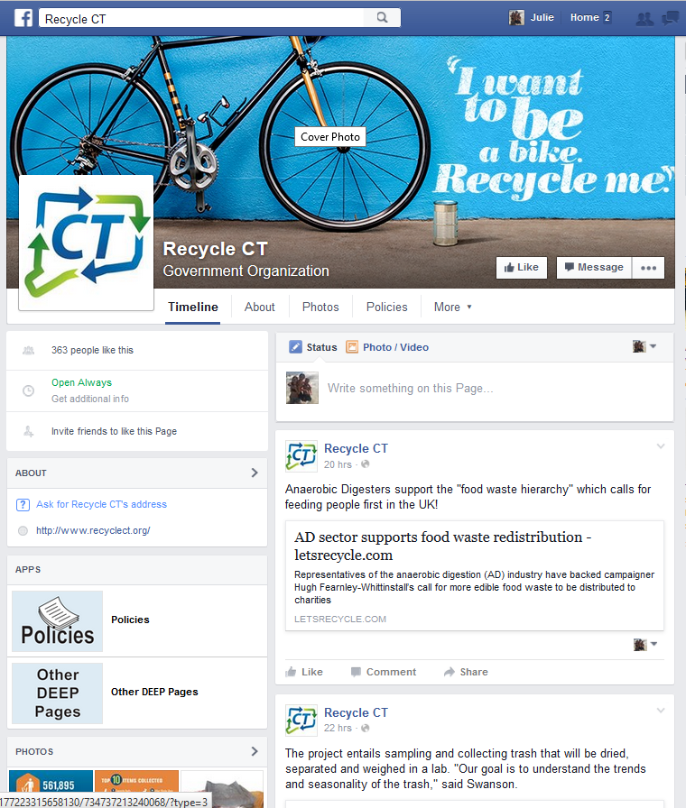

Slide 19
Facebook
How to set up your Facebook Page
Sign up for a Facebook account
- Must have a Facebook account to create a Page
- Go to www.facebook.com and fill out the sign up form that includes your First name,
Last name, email, password, birthday and gender
Sign into your account and click the dropdown arrow in the top-right corner
- Select “Create Page” option
3. Choose a business category for your Page
- Select from Local Business or Place; Company, Organization or Institution; Brand or Product; Artist, Band or Public Figure; Entertainment; or Cause or Community
Choose an industry-specific category
- Choose a category that matches your business and fill out basic information about your business including business name, address, city/state, zip code and phone number
5. Agree to the Facebook terms and conditions, click ‘save info’ and start connecting

Slide 20
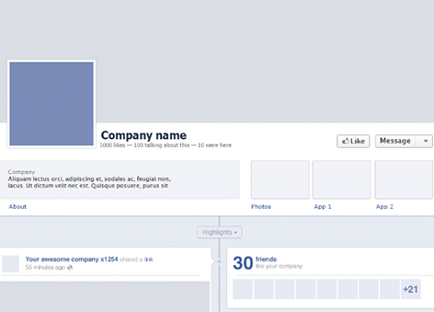
Facebook
Optimizing your Page
Cover Photo
Profile Picture
About Section

Slide 21

Facebook
Optimizing your Page
ABOUT SECTION
- Description of your business and your website address
- Include what your business does, what industries it serves and what its mission is
PROFILE PICTURE:
Dimensions: 180x180 pixels cropped to fit a square (company logo is ideal)
In the description section about your profile picture, include a statement about your business and your website URL
COVER PHOTO
Dimensions: RGB JPG file that is 851 pixels wide by 315 pixels tall
Should be relevant to your business or the industry that your business operates in and be changed on a monthly/bi-monthly basis
Include calls to action via text overlay with your phone number, website URL, etc.
Save image as a PNG file is using a text overlay instead of a JPG
Cover photo is not displayed on Smartphones

Slide 22

Facebook
Content
CONTENT IS KEY
As a business, it is important to remain focused on the quality of your content
Examples of potential posts:
  What can or cannot be recycled
  Recycling DIY projects
  How to make recycling easier
  New Hires
  Employee involvement in the community

Slide 23

Facebook
Content - Hashtags
Hashtags are the short links preceded by the pound sign (#) and are an integral way the online audience communicates.
Hashtags were born on Twitter but are also used on Facebook, Instagram, Google+, Tumblr and Pinterest. Facebook added hashtag support in June 2013. Clicking on Facebook hashtags will take you to a list of posts containing the same hashtag. The results are not limited to people you know.
Grit recommends only using hashtags for 1-3 words per post
Post should be simple and filled with content to direct the user back to your website or link that you are promoting.
When possible, follow trends and see what hashtags are trending. Use them if they are relevant to your business. Examples include #ThrowbackThursday or #FF

Slide 24

Facebook
Promoting social media presence
Achieve engagement through:
Post frequency
Business posts
Photos
Length of post
How the post looks visually

Slide 25
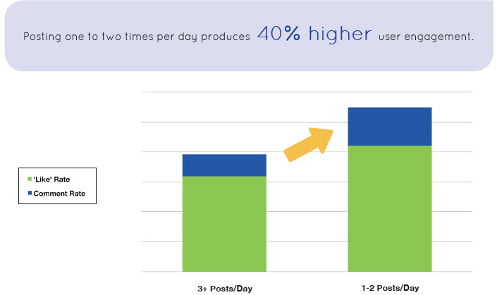
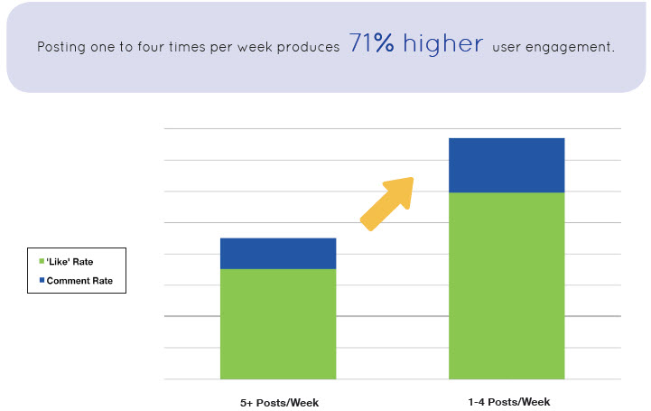
Facebook
Post frequency
Grit recommends that you post:
1 - 2 times per day 3 - 4 times per week

Slide 26
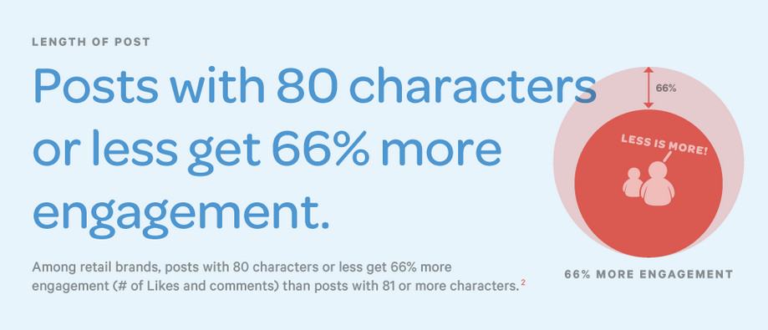
Facebook
Post Length
Shorter posts receive HIGHER engagement

Slide 27
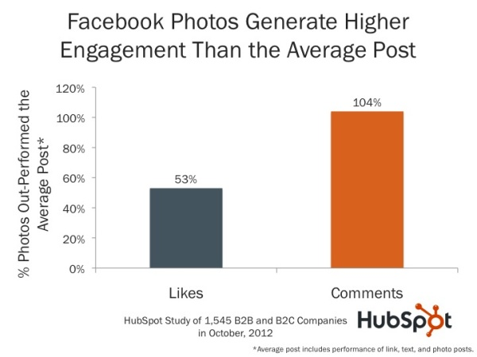
Facebook
Photos
Photos get 39% more interaction than text-based, video or link updates.
Photo updates generate more likes and 104% more comments than other types of updates.

Slide 28
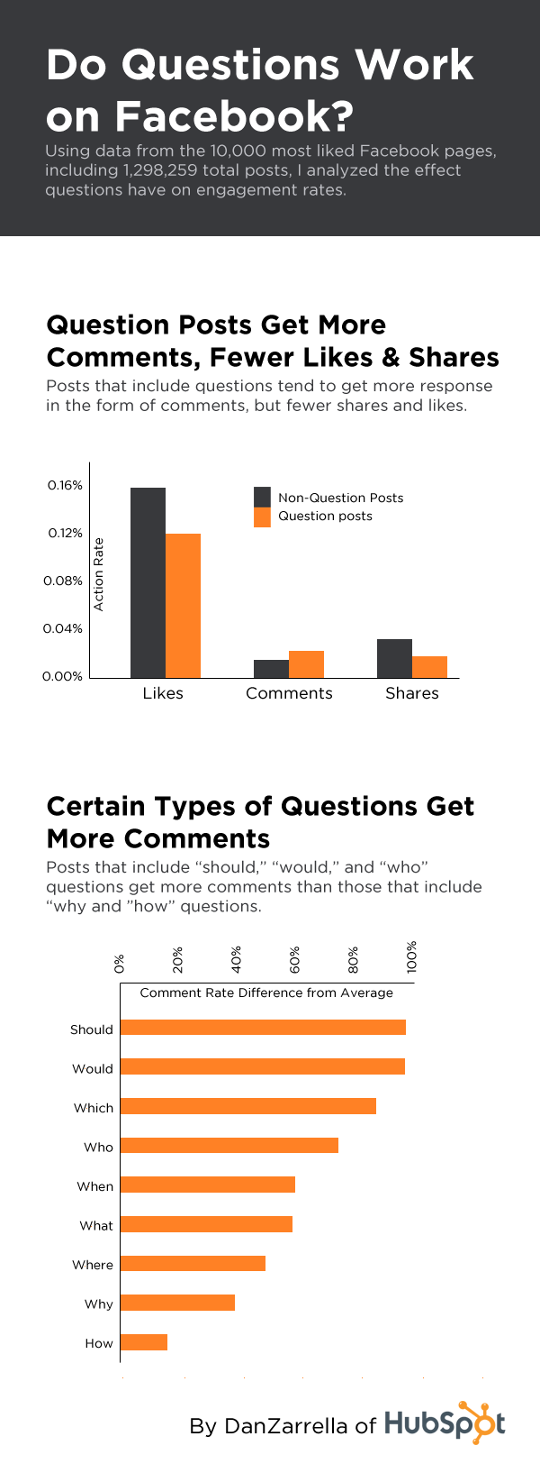
Facebook
Posts with questions

Slide 29
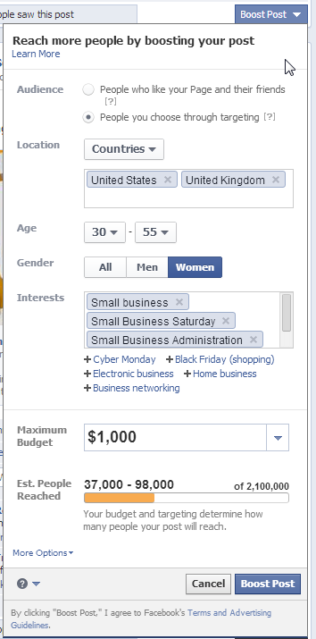
To Pay or Not To Pay?
Notes:
Enhanced Audience Targeting
Testing your ads to improve your creative and gain insights
Improve video reach and views
Reach mobile audience
Facebook insights – how are people engaging with your ads – metrics that track page performance, engagement, audience demographics, impressions, reach are just a few.
Facebook advertising is a platform that allows businesses to increase their brand awareness and sales through enhance targeting, different platforms, while having creative flexibility.

Slide 30
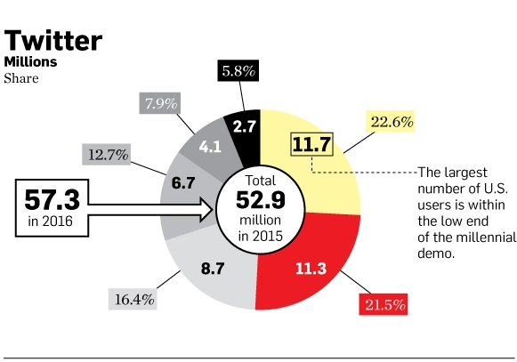
Twitter

Slide 31
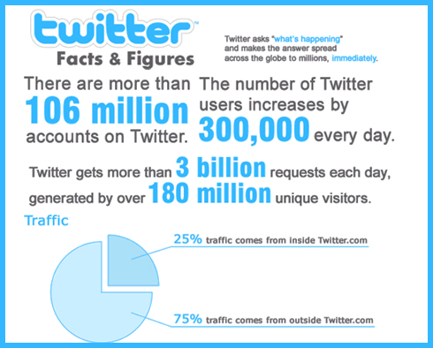
Why Use Twitter?
inspirationfeed.com

Slide 32

Twitter
Social media platform that allows users to create, share, and view 140-character messages called “tweets”
Tweets can include text, pictures, videos, or links.
80% of active users use the mobile app
1 billion visits to websites with embedded tweets per month
Average Twitter user follows 5+ businesses
Tweets with hashtags get 2x more engagement

Slide 33
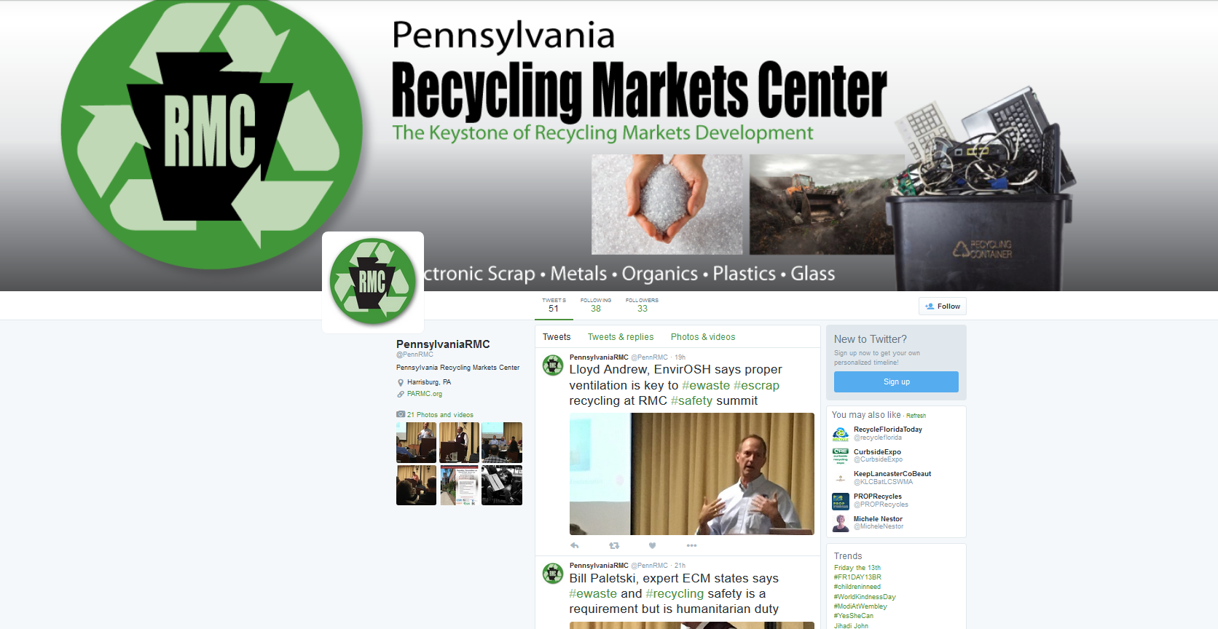

Slide 34
Content of Tweets
Tag other accounts in you’re a Tweet by typing the “@” key and then typing their twitter username. Make sure you click on the person/business you want to tag when it pops up after you type.
Add your location to a Tweet to let people know where you are at any given time (at the office, a conference, etc.)
Add links and URLs to your Tweet to direct traffic or to link to, for example, an article that is longer than 140 characters. A simple copy and paste will do the trick.

Slide 35
Hashtags
It is important that you use hashtags on Twitter. Simply type “#” and whatever tag you want to use, with no space between the hashtag and the words of the tag.
People from anywhere in the world can see that your tweet has appeared under a certain hashtag!

Slide 36
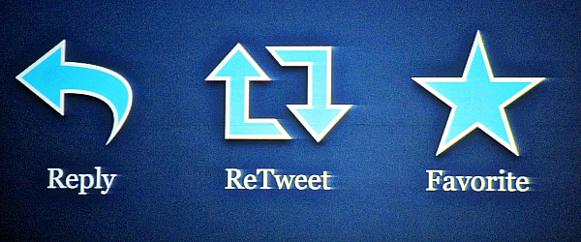
Retweeting/Liking Other Tweets
If you see a Tweet that you would like to share with your followers, click the “retweet” button. This tweet from another account will now show up on your account for all of your followers to see. For example, if Penn Waste tweets about how to recycle a Christmas Tree, you can “retweet” this exact post to add it to your own tweets.
When you “favorite” a post, it will not add that tweet to your own profile as Retweet did, but it will notify the account that made the tweet that you have enjoyed it.
“Reply” to another account’s tweet to add any comments. This will show up on your profile, as it is considered a “tweet.”

Slide 37

What to be Posting
Make posts frequent (2-3 times a week), but not excessive; excessive posting causes people to “unfollow” accounts because they become too bothersome.
Make posts relevant to your company. For example, don’t randomly post about the new iPhone coming out. You could post about things such as what to/what not to recycle and how to re-use materials.
Keep posts clean and professional, as they reflect back to who you are as a company.

Slide 38
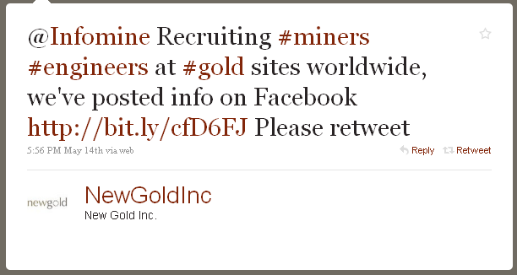
The tweet above is fairly engaging; there are multiple hashtags, another account is tagged, and a URL to an outside website is incorporated. We wouldn’t suggest having this much going on in one tweet. You can certainly add a few different points of interaction, but don’t go overboard.

Slide 39
What to be Posting (cont.)
Post about other businesses related to yours in the community and the world as well. For example, if the ABC Company has made a new and exciting development, post about it. Don’t forget to tag them in your posts if they also have social media accounts set up! You can also include new hire announcements and employee spotlights.

Slide 40

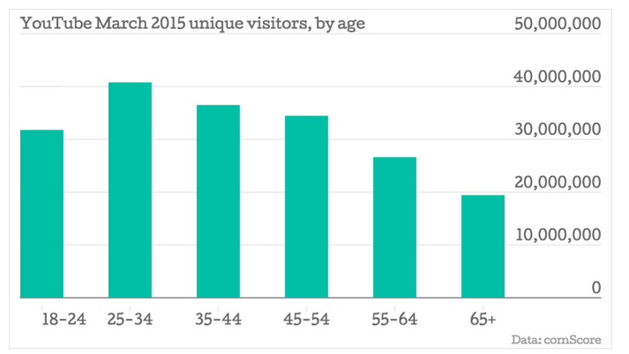
YouTube Audience
Notes:
While I’m not going to go into a lot about YouTube, it is important to know it’s the #2 search engine in the world.
Video strategy and channel

Slide 41
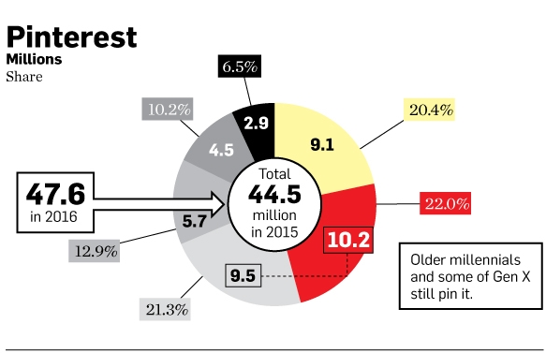
Pinterest

Slide 42
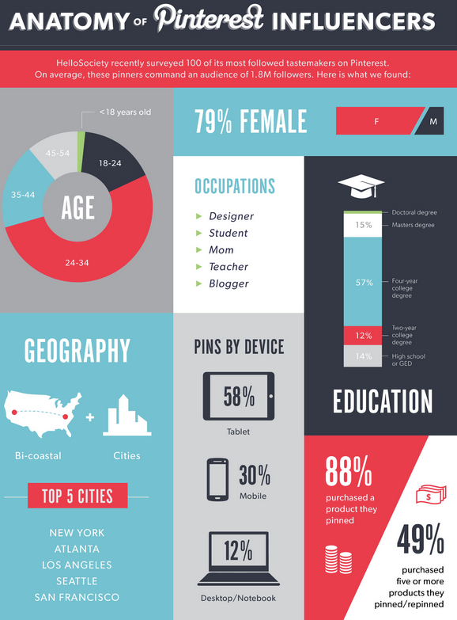

PINTEREST
2/3 of all pins generated from business websites
House pins on your website for maximum value
Pinterest shoppers purchase – Shopify users referred by Pinterest spend an average of $80 compared to Facebook retail of $40
Source: Pinterest & Jeffbullas.com

Slide 43
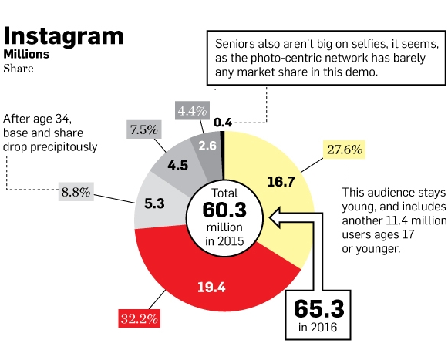
Instagram

Slide 44

Instagram
Photos (Square) & Videos (15 seconds max)
Cross-Social Sharing Platform
Mobile-Focused; Limited Desktop Usage
Hashtags are prevalent, limit 30 per post
Videos can be embedded into website

Slide 45
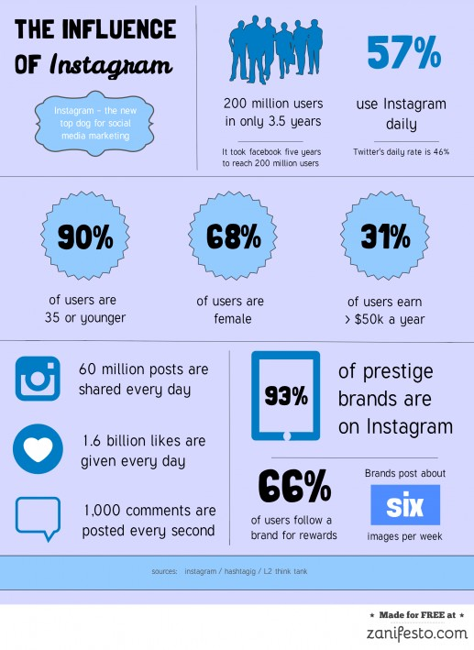
Instagram
Grew by 50% between March and December 2014 and exceeded the 300 million mark.
Engagement rates on Instagram are 15 times higher than Facebook and 20 times higher than Twitter.
Only 28% of marketers use Instagram
According to 2014 Pew Research Report

Slide 46

About Instagram
Platform in which users upload photos with captions to share with their “followers.”
Features include:
  Information/About section where you can write information about PARMC including who you are, what you do, and your location. In this section, you can also have the link to your website PARMC.org.
  Filters for your photos being uploaded. These should be used sparingly, as some filters are distracting and “over-the-top.”
  Share to Facebook and Twitter. Right before you publish your photo, you will have the option of “sharing” your photo to Facebook, Twitter, or both. Your photo will appear in the form of a caption with a link on Twitter, and the actual photo with the caption on Facebook. Users who see your Instagram post that was shared on Twitter or Facebook are able to see that the photo originally came from your Instagram account, so this drives more users to your Instagram account as well.

Slide 47
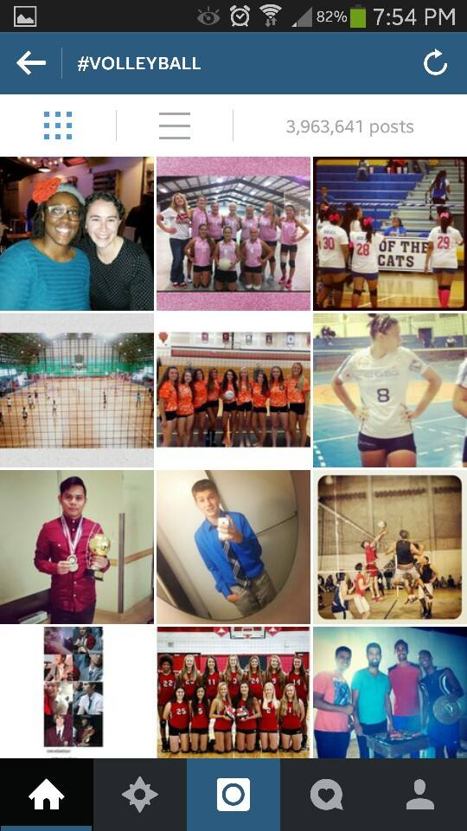
Your Posts- Descriptions/Hashtags
Use a description for every post you make. Use hashtags (#) that are applicable to your business on every post (ex: #PARMC, #PARecycling, #RecyclingMarketsCenter) and include photo-specific hashtags.
Hashtags put your photo under a master page of all photos with that same hashtag from every Instagram user. Therefore, if anyone were to search any of the hashtags you used in a post, they could possibly stumble upon your post (ordered according to time).
Hashtags go right in with your caption, so you have to actually type them all out.

Slide 48
Your Posts- Location, URL, Responses
Use your location in every post so that people can tap on the location of your photo and see where your business is located.
Add URL (i.e. parmc.org) to the captions of your pictures to drive traffic to your website.
If users comment on your pictures, especially with a question, RESPOND! When responding, make sure you tag the person you are responding to by typing the “@” key with their username. This is the only way that they will get a notification that you have responded to their comment.

Slide 49
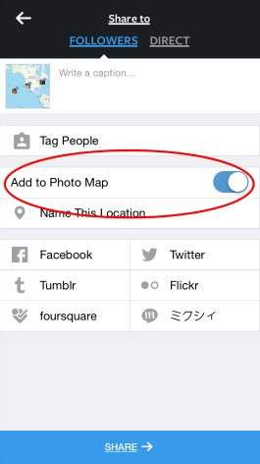
Insta-Map
Red circle indicates the place in which you insert the location the picture was taken from.
Insert a caption by typing where it says “Write a caption…”
Tap on the Facebook and Twitter icons to share to these platforms; the platforms should turn blue to indicate that you have selected them.
Blue share button on the bottom publishes your picture!

Slide 50
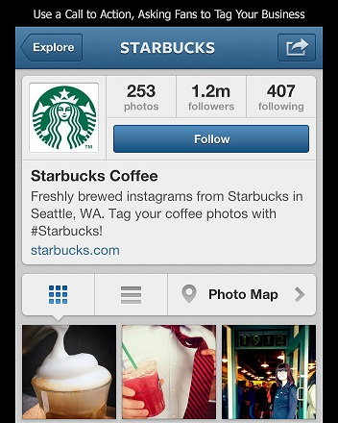
Following Accounts
To increase awareness about your business, follow other Instagram accounts related to your business. This way, these other businesses and accounts can serve as a model for you to base your content off of.
Follow the accounts of local businesses to show them that you’re present and you care; this gets them talking to the people they know about your business as well.
Simply tap on the blue “Follow” button to follow any business or personal accounts, if necessary.

Slide 51
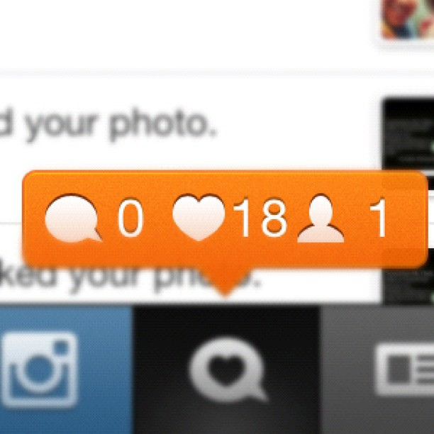
Your Account Notifications
“Likes” on your pictures (double-tap to like another account’s picture-this shows up on the “likers” of the picture, which is another way people can find you), people who have tagged you in a picture, and new follower notifications will pop up in orange as soon as you open the app.
Notifications tab is the tab along the bottom with the heart inside the speech bubble. Double-tap to expand.

Slide 52
Why Use Instagram?
20% of Internet users between 16 to 24 have an Instagram account.
1 in 4 active users visit Instagram on a daily basis.
30% have discovered a brand/product via a branded social network post.
25% say they spend 2 to 4 hours online on their mobile each day.
6 in 10 say having the latest technological products is very important to them.
http://blog.twmg.com.au/tag/instagram-infographic/

Slide 53



Instagram Content
Examples of images that could be posted:
  Images of items and a caption depicting how to recycle those items
  Images of recycling projects that PARMC is currently working on
  Images of recycled DIY projects

Slide 54
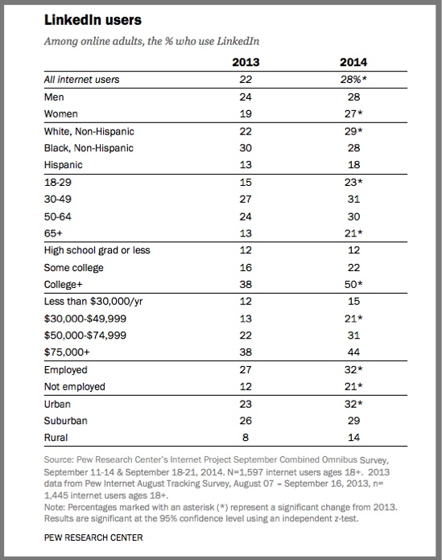

Which Channels Are Best?

Slide 55

WHAT IS LINKEDIN?
LinkedIn
Your online resume (both personally & for businesses)
  A place where your business can showcase their professional and philanthropic involvements as a whole.
  People use LinkedIn for their own personal uses as well.
  You are in charge of creating your online brand – your business’ skills and gifts are displayed online and are being seen by people every day!

Slide 56
WHY USE LINKEDIN?
Why use LinkedIn?
Manage your career
Create a professional profile
Demonstrate knowledge
Connect with relevant industry leaders and professionals
Give/receive recommendations and endorsements
Research companies, organizations, jobs
Worth noting…
  90% of employers review candidate’s online profiles
  70% base hiring decision on what they find or don’t find online

Slide 57
How to create a profile
Customize your URL
  Ex: www.linkedin.com/company/grit-marketing-group
Customize your title
  120 characters max
  Make sure you use keywords that relate to your industry and business name
  Feel free to get creative depending on your industry
Notes:
There are some basic components to creating an all star profile on linkedin – headshot, customized URL, title, background photo, summary, experience, skills, recommendations, volunteering, etc.

Slide 58
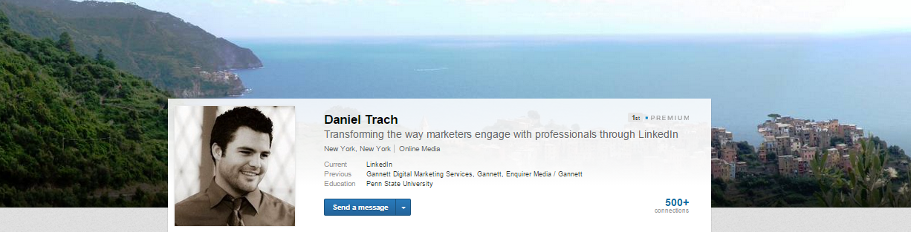
How to create a profile
Customize your background photo
  Make it relevant to your passions, interests, travels or hobbies

Slide 59
How to create a profile
Create a summary – very important
  2000 character limit
  Explain what PARMC is, how you help people, things you do in the community, your goals, etc.
  Briefly explain what kinds of jobs your employees are hired to do; if anyone were to be looking for a job with you, what can they expect? If you are used as a reference a past employee for their personal LinkedIn profile, what sets them apart from the crowd because they have worked for you? Highlight what makes your company credible.

Slide 60
How to create a profile
Recommendations
  Request recommendations from other businesses and even personal LinkedIn members.
Other fields
  Add media
  Publications
  Foreign languages (if applicable)
  Awards
  Philanthropic activities as a whole

Slide 61
How to create a profile
  Always personalize the message – invite through their personal email and specify how you are connected (personal and business)
  If you don’t have their email, click “friend” – this will bypass the requirement of having their email to connect
  Only connect with people you know – if you don’t know them, ask for an introduction from your current connections
  *Selectively connect*
    General rule of thumb – connect with every potential employee before meeting with them!

Slide 62
Driving traffic
  Add your LinkedIn customized URL to your “resume” and email signature
  Share articles and updates to appear in others’ timeline
  Connect with your Twitter account to share on your Twitter feed as well
  Post a blog
  Join groups that are relevant to your industry and efforts

Slide 63
Connecting
Connecting with people you don’t know
  Join groups to create commonality
  Send “get introduced” request to mutual connection
  Write carefully worded LinkedIn request pointing out commonalities

Slide 64
Content ideas
Examples of potential LinkedIn posts
  Article shares about innovations in the recycling industry
  Posts about projects that PARMC is currently working on
  Article shares that mention PARMC
  Posts about recycling tips or information
  New hires, employment openings

Slide 65
ADDITIONAL TIPS
Privacy
  Privacy
    When you search for someone and view their profile, they will see this unless you disable settings.
    If you want them to know you’re looking, then keep it turned on
      Passive-aggressive “poke”
    If you want to search privately, make sure you edit your privacy settings

Slide 66
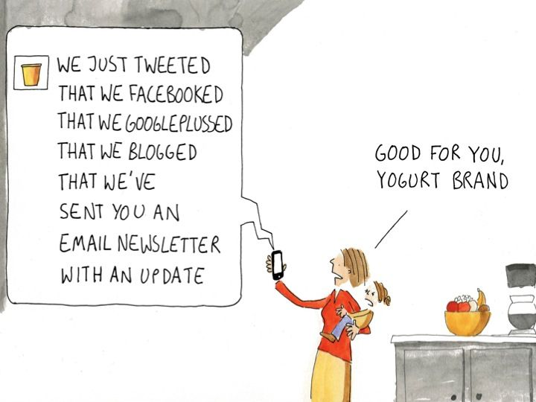
Content is King!

Slide 67
Content is King!
Avoid Being Overly Sales-Driven | Develop a Personality
Behind the Scenes/Inside Facts | Showcase Community Connections
Staff Profiles/Team Connections | Tag Related Businesses/Partners
Polls/Questions | Include Photos & Videos
Share Related Content | Tie Into a Trending Topic
Infographics | Encourage Action

Slide 68

Get Engaged
Integrate Popular/Trending Hashtags
#tbt, #FlashbackFriday, #WinningWednesday
Contests & Social Perks/Incentives
Special Offers for Check-Ins
Encourage & Reward Sharing, Comments & Tagging

Slide 69
Go Mobile or Go Home
Mobile is rapidly rising to become a first-choice device for social behaviors
If you want people to take action from your social channel to your website, make sure your site is ready

Slide 70

Public Relations & Social Media

Slide 71
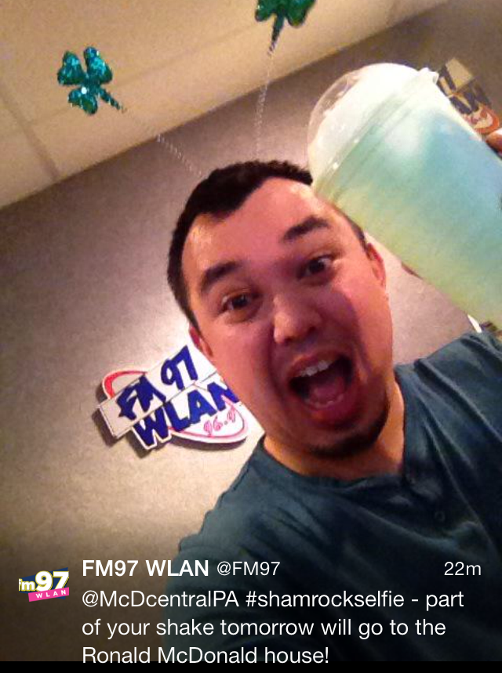
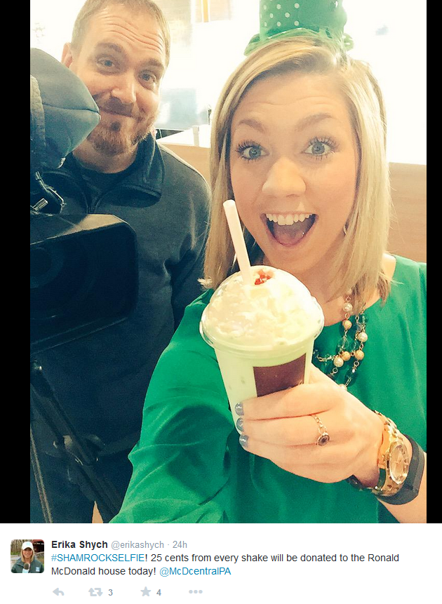
Public Relations & Social Media
Be Prepared to Respond
Plan for Crisis Scenarios
Employee Policies
Content Control & Monitoring
Social Media as a Media Resource

Slide 72
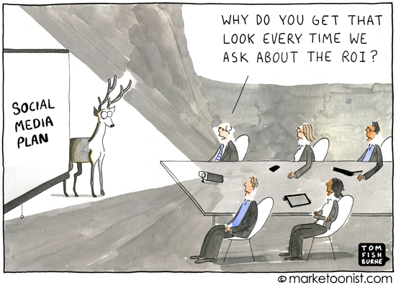
Social Media ROI

Slide 73
THANK YOU!
Julie Lando
717-885-0014
Julie@creategrit.com

Slide 74
QUESTIONS?
PLEASE USE THE GO TO WEBINAR DIALOGUE BOX

