Slide 1
Recyclers Guide to Understanding SMM Part I:
What do NRC Members currently do with SMM?
SMM Summit Webinar • February 11, 2015
Julie L. Rhodes, SMM Summit Committee Co-Chair
julielrhodesconsulting@gmail.com 317.371.2788
Notes:
Thank you for the opportunity to wrap up this first of two NRC webinars as your final speaker. As a person who has worked closely with recycling organizations and RO’s members for two decades, I understand how this paradigm shift from recycling to “sustainable materials management” can be challenging to get your arms around.

Slide 2
Traditional Solid Waste Management Hierarchy
Waste Prevention /
Source Reduction
Reuse / Repair / Upcycling
Recycling / Composting
Final Disposal
Waste-to-Energy
Landfilling / Incineration without Energy Recovery
Notes:
For 25 years we have used that solid waste management hierarchy to create plans about how to manage and reduce our waste and divert waste. In the beginning, most resources were focused on recycling, but today, communities offer wide-spread composting … reuse and repair has undergone a resurgence, and businesses and households are looking for ways to avoid the generation of waste.

Slide 3
Collection/ Material Recovery/ Processing
Traditional
Recycling Infrastructure
The Recycling Symbol
Manufacturing/ Market Development
Buying Recycled/ Closing the Loop
Notes:
We have also relied very heavily on the traditional recycling symbol and though it has been misused a great deal over the years, we know that the recycling symbol provides for the three prongs of recycling infrastructure: Collection and Processing; manufacturing those recyclables into new products; and then those products being purchased and used, before the cycle starts all over again. While recycling is a critical component of any comprehensive solid waste management program, we realize that it is only a part of the answer for reducing waste.

Slide 4
Zero Waste
Goals for Waste Diversion or Recycling
75%
50%
Measuring Downstream and/or Creating Formulas
25%
10%
Notes:
We also know that most states and some municipalities have set recycling or waste reduction goals as a way to measure the success of all the resources spent on programming and education. Some communities have even initiated Zero Waste goals as a means for diverting as much waste as humanly possible.
In our efforts to measure, however, we struggle to find a legitimate means for measuring that which makes up all the other rungs of the waste management hierarchy – prevention/reduction, reuse, repair, and so on. With aggressive recycling and composting programs, we can recycle a lot, but not ALL, of material.

Slide 5
But many things outside our control effect our ability to be successful recyclers....
?
What products are manufactured
How products are manufactured
What products are consumed by whom
Where products are consumed
What materials are collected (contractual or desired)
Toxicity of materials
How materials are processed
Where markets exist
Notes:
But many things fall outside our control, yet effect our ability to be successful recyclers.
We recognize that Issues such as local and/or regional markets, technology, economies of scale – these come into play, and even though we are working on these issues all the time, conditions change that throw a monkey wrench into our programs and create challenges for the recycling practitioner.

Slide 6
Just when we think we have it figured out...
Dairy farms add pigment to their milk jugs that effect HDPE pricing and processing
Electronic manufacturers used various plastic grades and screws that effect demanufacturing and recycling
PET bottles are wrapped in PVC labeling creating a contaminant
Biobased plastics show up and risk contamination of PET
Carpet can't be recycled because it is made with two incompatible resins
Some export markets prove illegitimate
Vacuum packaging of products
Electronic components in shoes, household items, toys
........any design or manufacturing or material change upstream can effect the ability to recycle it downstream
Notes:
And, just when we think we have it all figured out..
Here are just some examples of challenges that I’ve witnessed and experienced over my 20+ years of working on recycling efforts.
Anything that contaminates our recycling stream or creates more residual debris takes us farther from our goals and make our programs more costly and/or less economically viable.
We know that we can be cruising along, adding more and more materials into our collection programs, building new market opportunities (locally or abroad), incorporating more technology (like eddy current or optical sort or new pulping technology at the mill for increased fiber recovery or de-inking) -- but when decisions are made upstream without our prior knowledge or awareness, it becomes a set back for our programs – and it can be a costly setback.

Slide 7
More examples of challenges ....
Items that cannot be repaired (shoes, appliances)
Batteries that cannot be replaced (iPods)
Over packaging
Plastic bags creating maintenance challenges at MRFs
Single-stream contamination
Mixed waste processing contamination
Notes:
Here are a few more examples of issues that have arisen that create challenges for recycling, or create new levels or kinds of contamination in our recycling stream.
There exists this constant pull between increasing our quantities of materials for diversion and recycling, balanced with the quality and marketability of materials to support the 100’s of thousands of jobs and thousands of businesses who rely on this materials as their feedstock.

Slide 8
What are the opportunities through SMM?
National policy dialog
  CARE – Carpet industry dialogs
  Electronics Producer Responsibility
  RBRA – Battery collection and recycling
Increase communication between upstream and downstream
  Develop considerations for material discards from design
  Awareness of what might be coming down the pike
  Opportunity to influence those decisions
Meeting waste reduction and recycling goals
Notes:
There have definitely been some multi-stakeholder efforts that bring together manufactutres with policy-makers and recyclers to work collectively toward common goals for recycling. Carpet, electronics and the rechargable battery manufacturers are just a few examples of where the multi-stakeholder approach has led to positive and lasting outcomes.
We know that this kind of open dialog among many key stakeholders can be effective, and the SMM Summit is NRC’s initiative to progress all the issues that you are working on locally in a strategic and comprehensive manner – reuse, recycling, composting, recycling economic development and recycling jobs, product stewardship and so on.
This multi-stakeholder approach opens the lines of communications, helps us understand how and why decision are made by marketers or manufacturers that effect our ability to manage discards in a sustainable way. And, it gives us the opportunity to potentially influence decisions. We believe that this IS the approach needed to help our communities meet their waste reduction and recycling goals.

Slide 9
Air Pollution
Jobs
Waste Prevention
egulations
Design
Manufacture
Green Building Standards
Distribute
Reuse
Energy Efficiency
Purchase
upstream
Consume
Climate Action Plans
Collection
Process
Distribute
Corporate Policies
downstream
Regulations and Laws
Re-
manufacture
Water Pollution
Sustainable Materials Management Model
Notes:
In this linear diagram, you see all the downstream aspects of waste generation and recycling, with opportunities to prevent waste or reuse materials along the way. We begin to start thinking about not just the downstream, but to also realize the upstream opportunities for ensuring more effective and efficient material management downstream.
Outside this linear model, you also see many issues that come into play beyond just the design and manufacture. Issues like regulation or local climate action plans, concerns over pollution generated in the extraction of resources and manufacture of products, other influences such as green building standards or corporate policies to phase out toxic materials. There are many outside factors that cannot be fully integrated into a linear model.
And, going back to that original recycling symbol, we can comprehend the concept of a “cycle”.

Slide 10
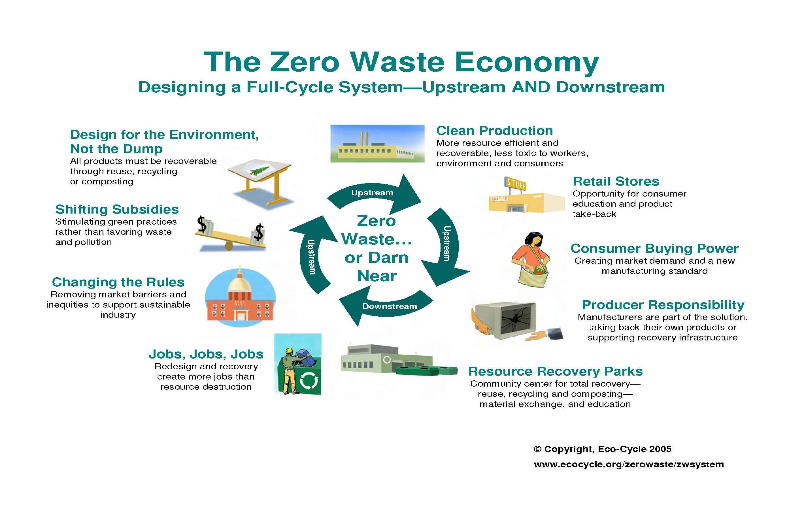
SMM and the Circular Economy
Copyright Eco-Cycle, 2005
Notes:
Therefore, we need to be looking at discards management in terms of a circular economy, whereby we consider a product at every aspect of its life from design to material choices to product use and opportunities for discarding the product in the most sustainable manner possible, whether that is easily and cost-effectively recycled, composted, OR reused over and over during the product life.
Or, if the product is made more durably so that it can be repaired or upgraded to extend the product life;
Or if the product is free of toxins to reduce risks and costs in use and end of life.
In the old paradigm of the solid waste management hierarchy, there simply wasn’t a means for incorporating all these aspects and considerations for sustainable management of our discards. NRC, in partnership with EPA and many other stakeholders now wants to make your job as waste managers and recyclers easier, more efficient and more effective through sustainable materials management.

Slide 11
Thank you! Questions?
Julie L. Rhodes
National Recycling Coalition
Co-Chair, Sustainable Materials Management Summit
Julie L Rhodes Consulting
317.371.2788
julielrhodesconsulting@gmail.com
Notes:
Thanks. We’ll now unmute our other two speakers and begin to address some of your questions. Remember, submit your questions through the Chat function.

