Slide 1
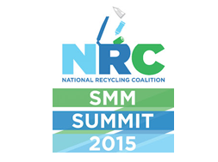
How Recycling Managers Can Best Contribute to Achieving Sustainable Materials Management
February 18, 2015
David Allaway, Oregon Dept. of Environmental Quality

Slide 2
Overview
What is “materials management”?
Materials management and discards management compared
How does recycling contribute to sustainable materials management

Slide 3
Materials Management: 2 Working Definitions (US EPA)
“Materials management is an approach to using and reusing resources most efficiently and sustainably throughout their lifecycles. It seeks to minimize materials used and all associated environmental impacts.”
“Materials management refers to the life cycle of materials as they trace their course through the economy, from raw material extraction to product manufacture, transport, use, source reduction, reuse, recycling, and disposal.”

Slide 4

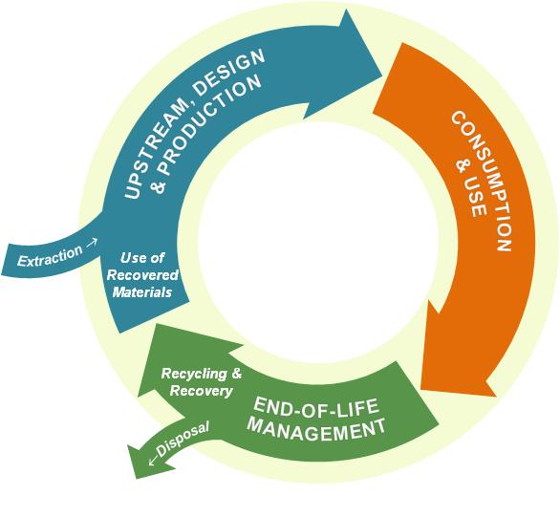
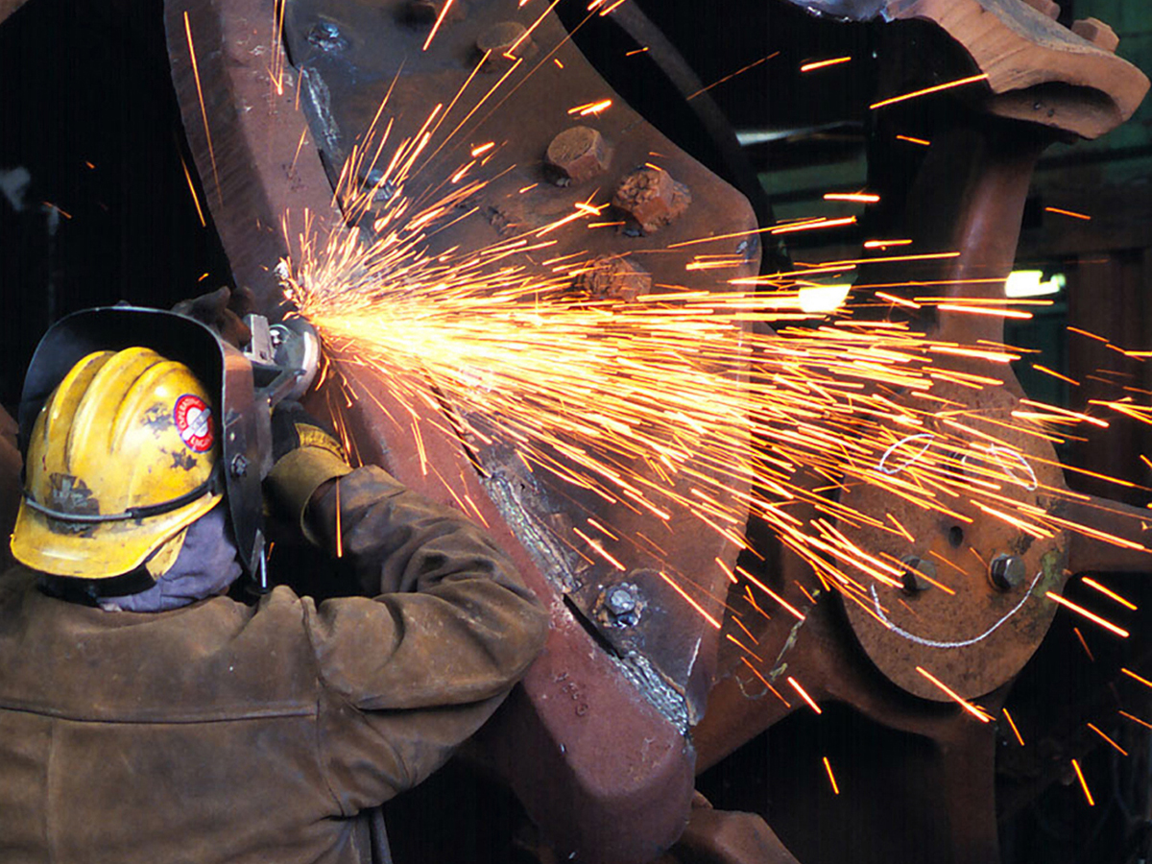
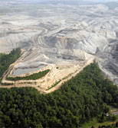
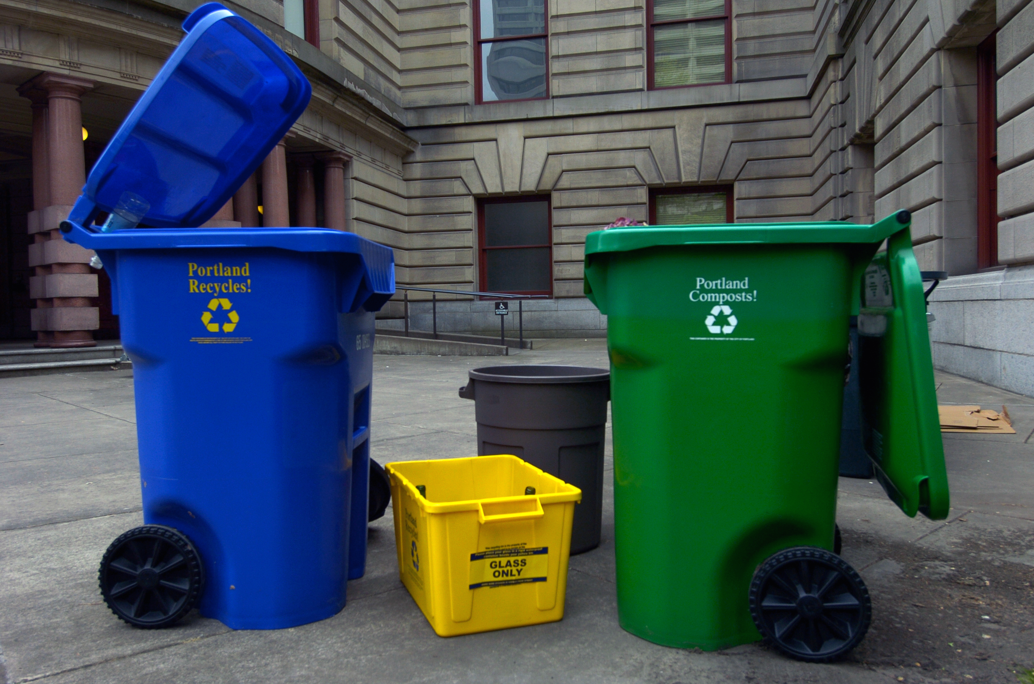
Materials Management:
A “Life Cycle” View
Recovery

Slide 5
“Discards management” and “materials management” compared
 | Discards Management | Materials Management
Goal | Managing discards | Sustainability
Lifecycle | Primarily downstream | All stages
Environmental scope | Emissions from waste facilities; resource conservation from recovery | All pollutants, resources
Partners | Waste generators, waste industry, users of recovered material | Everyone involved in the life cycle of materials

Slide 6
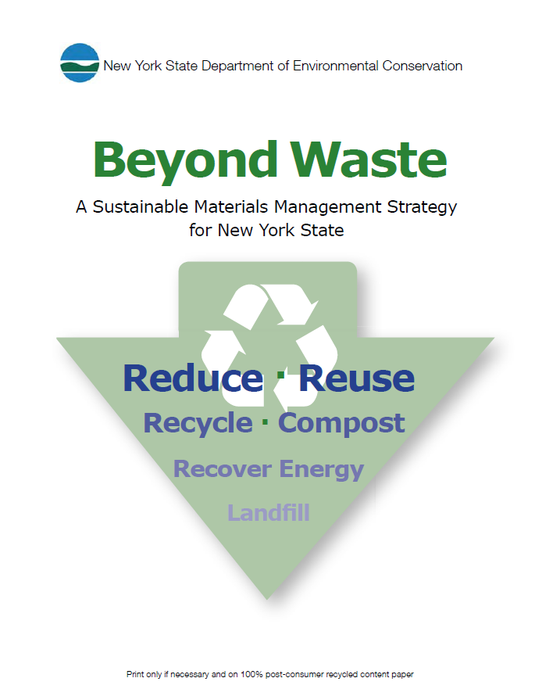
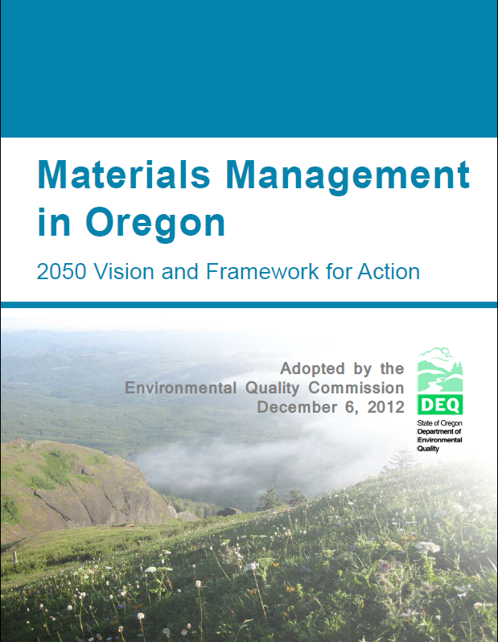
Materials Management?

Slide 7
Why Materials Management?
Answers Complex Questions about Choices and Impact - Everyday, people make choices about products and services:
  Which products do we buy?
  What are they made of and how are they made?
  How do we use them?
  What do we do with stuff when we’re through with it?
All of these choices have environmental consequences – some large, some small, almost all unseen.
Multi-attribute - Very narrowly focused attributes like “recyclable”, “biodegradable”, or “organic” don’t tell us about all of the other potential environmental impacts that occur in all stages of the life cycle.
Offers Inter-related Solutions - SMM requires interaction between programs that deal with a wide range of media (air, water, etc.) to identify and address "hotspots" which cause major environmental impacts.
Source:
US EPA (2015)

Slide 8
From “Discards Management” to “Materials Management:
A full view of impacts across the life cycle
A full view of actions across the life cycle

Slide 9
From “Discards Management” to “Materials Management:

Slide 10
From “Discards Management” to “Materials Management:

Slide 11
From “Discards Management” to “Materials Management:
A full view of impacts across the life cycle
A full view of actions across the life cycle
  Why? Because most impacts are “upstream”

Slide 12
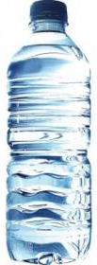
Example of Actions Across the Life Cycle: PET Water Bottles
Normalized impact
(baseline w/37% recycling = 100)
“Baseline” = PET, half-liter, 13.3 grams, 0% post-consumer recycled content (PCR), on-site molding,
purified municipal water (reverse osmosis, ozone and uv), 50 miles to retail, 5 miles home-to-retail,
co-purchase w/24 other products, no chilling.

Slide 13
Example of Actions Across the Life Cycle: PET Water Bottles
Normalized impact
(baseline w/37% recycling = 100)
“Baseline” = PET, half-liter, 13.3 grams, 0% post-consumer recycled content (PCR), on-site molding,
purified municipal water (reverse osmosis, ozone and uv), 50 miles to retail, 5 miles home-to-retail,
co-purchase w/24 other products, no chilling.

Slide 14
Example of Actions Across the Life Cycle: PET Water Bottles
Normalized impact
(baseline w/37% recycling = 100)
“Baseline” = PET, half-liter, 13.3 grams, 0% post-consumer recycled content (PCR), on-site molding,
purified municipal water (reverse osmosis, ozone and uv), 50 miles to retail, 5 miles home-to-retail,
co-purchase w/24 other products, no chilling.

Slide 15
Example of Actions Across the Life Cycle: PET Water Bottles
Normalized impact
(baseline w/37% recycling = 100)
“Baseline” = PET, half-liter, 13.3 grams, 0% post-consumer recycled content (PCR), on-site molding,
purified municipal water (reverse osmosis, ozone and uv), 50 miles to retail, 5 miles home-to-retail,
co-purchase w/24 other products, no chilling.

Slide 16
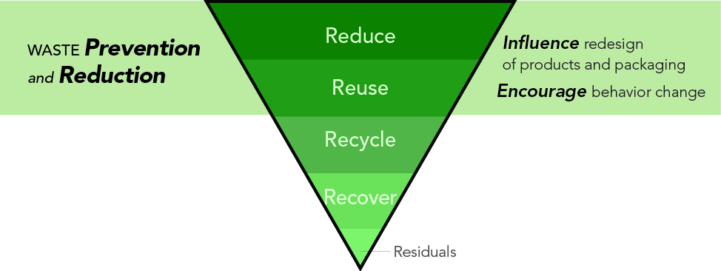
The “Solid Waste Management” Hierarchy

Slide 17
Materials Management
Recovery

Slide 18


Slide 19
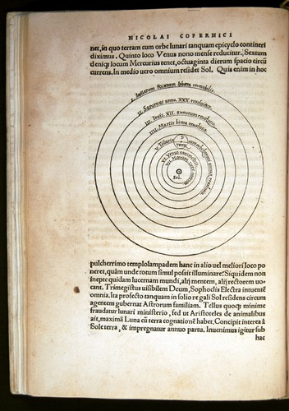

Nicolaus Copernicus

Slide 20
World View #1: Recycling is Independent of Other Life Cycle Stages
The life cycle of materials consists of several discrete parts (production, transportation, end-of-life, etc.)
If each part is optimized (independent of its effects on the larger system), the whole system is optimized
Recyclers should maximize recycling

Slide 21
World View #2: “Systems Thinking”
The life cycle of materials consists of several discrete parts (production, transportation, end-of-life, etc.)
Recycling is a means to an end, not an end in-and-of-itself
Recycling may effect the rest of the system
Recycling should be maximized but only to the extent it achieves the broader end (e.g., resource conservation), and only after considering how it effects the big picture (whole system)

Slide 22
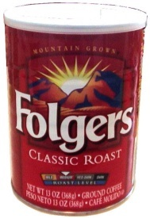
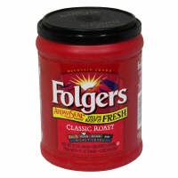
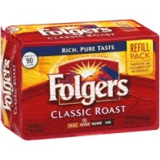
Design for Recycling? Design for Prevention? Design for Environment?
Coffee Packaging (11.5 oz product)
Material
Steel can, plastic lid
Plastic container and lid
Flexible pouch
Package Weight
~4 oz.
~3 oz.
~0.4 oz.
Recyclable by Consumers?
Yes
Yes
No
Energy Used (MJ/11.5 oz)
4.21
5.18
1.14
GHG Emissions (lbs CO2e/11.5 oz product)* | MSW Waste Generated (lbs./ 100,000 oz. of product)
0.33 | 1,305
0.17 | 847
0.04 | 176
Source:
US EPA

Slide 23
The “Solid Waste Management” Hierarchy
DEQ Waste Prevention Strategy: www.deq.state.or.us/lq/sw/wasteprevention/wpstrategy.htm

Slide 24
Food for Thought
“The environmental goals that motivate recycling are often best served by less rather than more recycling – that is, by preventing the generation of waste in the first place.” -Frank Ackerman (in “Why Do We Recycle?”)
“Picking up and reclaiming scrap left over after production is a public service, but planning so that there will be no scrap is a higher public service.” - Henry Ford

Slide 25


Slide 26
Thank You
David Allaway
Oregon Dept. of Environmental Quality
allaway.david@deq.state.or.us

