Slide 1
National Recycling Coalition Annual Members’ Meeting
Fiscal Year 2018 – 2019
Treasurer’s Report

Slide 2
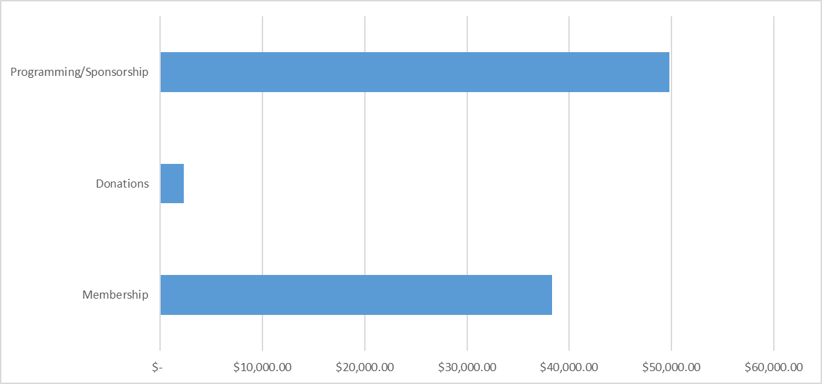
Revenue Amount per Category
Notes:
Note Programming became NRC larges revenue generator in 2018/2019. It was less than $20K in 2017/2018.

Slide 3
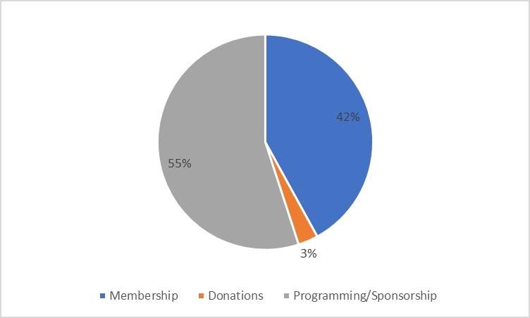
Revenue Percent by Category
Notes:
Programming in 2018/2019 Is 55% in 2017/208 it was 17%.

Slide 4
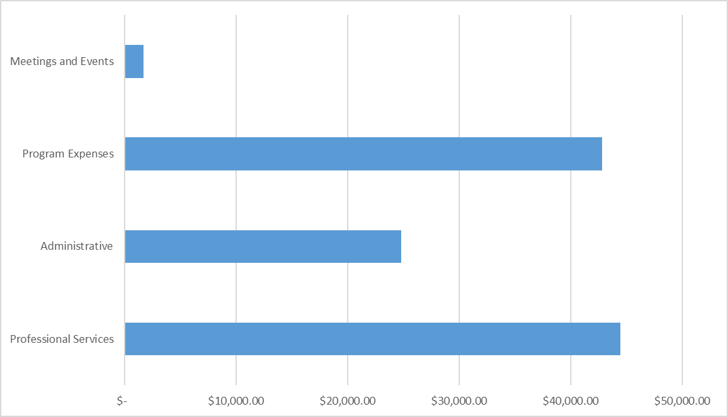
Expense Amount per Category
Notes:
Program expenses went up

Slide 5
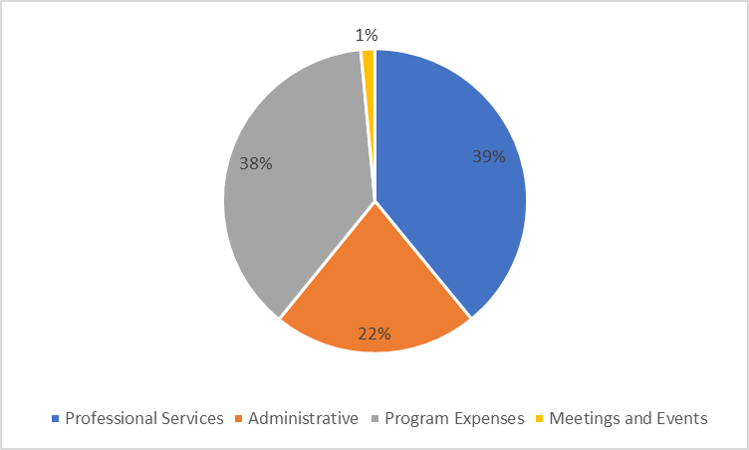
Expense Percent by Category
Notes:
2017/2018 program exp were only 18%, profess services was 56 and admin 21. Better alignment this year!

Slide 6
Asset Totals EOY
Notes:
Unrestricted has declined below $50K

Slide 7
Liability Totals EOY
Notes:
Liabilities increased with slow paying members

Slide 8
Thank you for your continuing support! Together, we are recycling.
For a detailed report, go to:
http://nrcrecycles.org/board-business/
Notes:
Overall summary - NRC needs to raise revenue

