Slide 1

National Recycling Coalition
Murray Fox Scholarship
&
Annual Awards

Slide 2

National Recycling Coalition
Murray Fox Scholarship

Slide 3

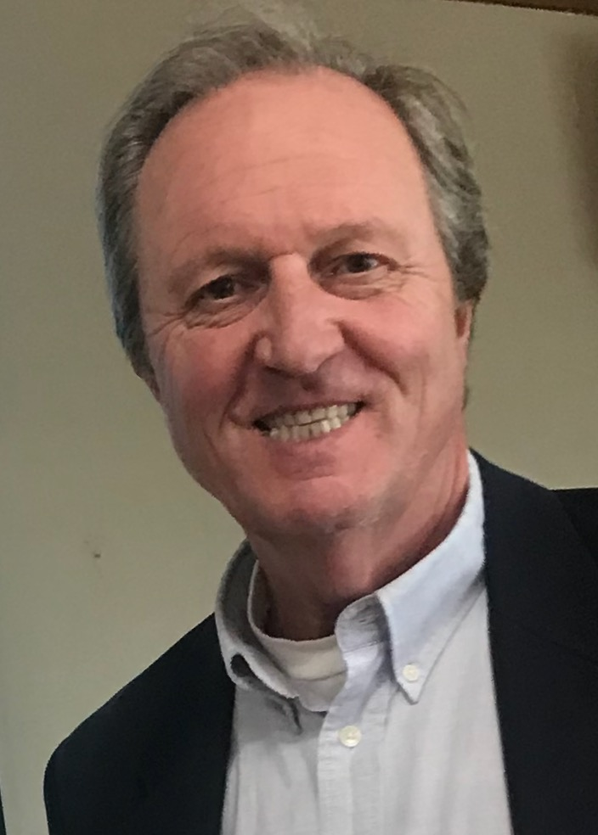
information resources
professional development
recognition and support
www.nrcrecycles.org/campus

Slide 4
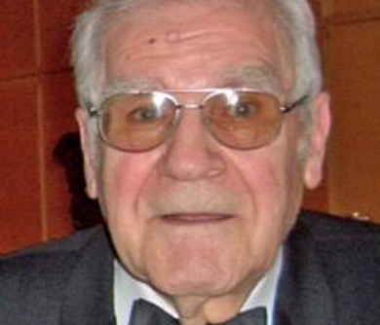
Murray J. Fox
1924 - 2018

Slide 5
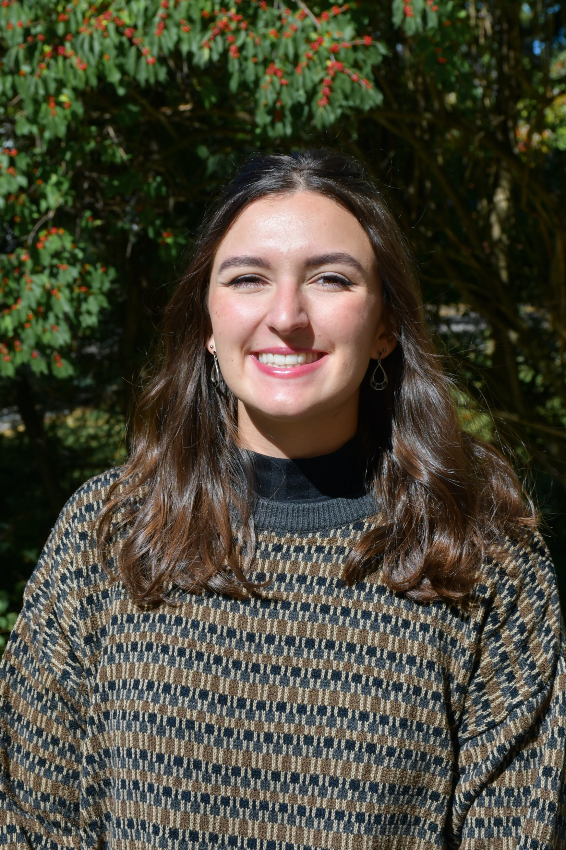

2024 NRC Fox Scholarship Recipient
Annie Dudley
Michigan State University
Urban and Regional Planning

Slide 6
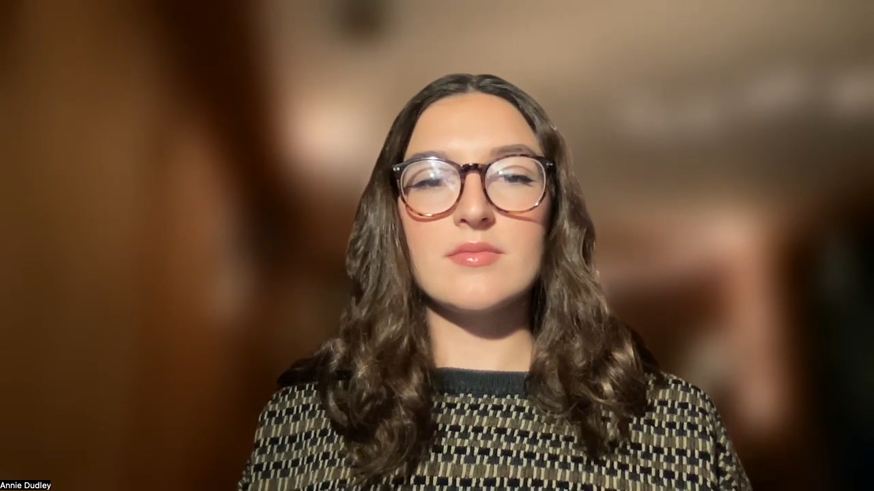

Slide 8
Thank You!
www.nrcrecycles.org/campus

Slide 9
National Recycling Coalition
Annual Awards for Outstanding Achievement

Slide 10
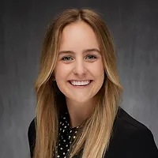


Outstanding Recycling Organization
National Stewardship Action Council
  Accepted by Jordan Wells
Notes:
Outstanding Recycling Organization
National Stewardship Action Council (NSAC) accepted by Jordan Wells
The National Stewardship Action Council, with Jordan Wells at the helm, is dedicated to fostering a circular, equitable economy. Through collaborative efforts between public and private sectors, NSAC develops strategies to reduce waste, curb pollution, and support sustainable systems. By advocating for producer responsibility, the organization sets a benchmark for systemic changes that protect the environment and create resilient communities.

Slide 11
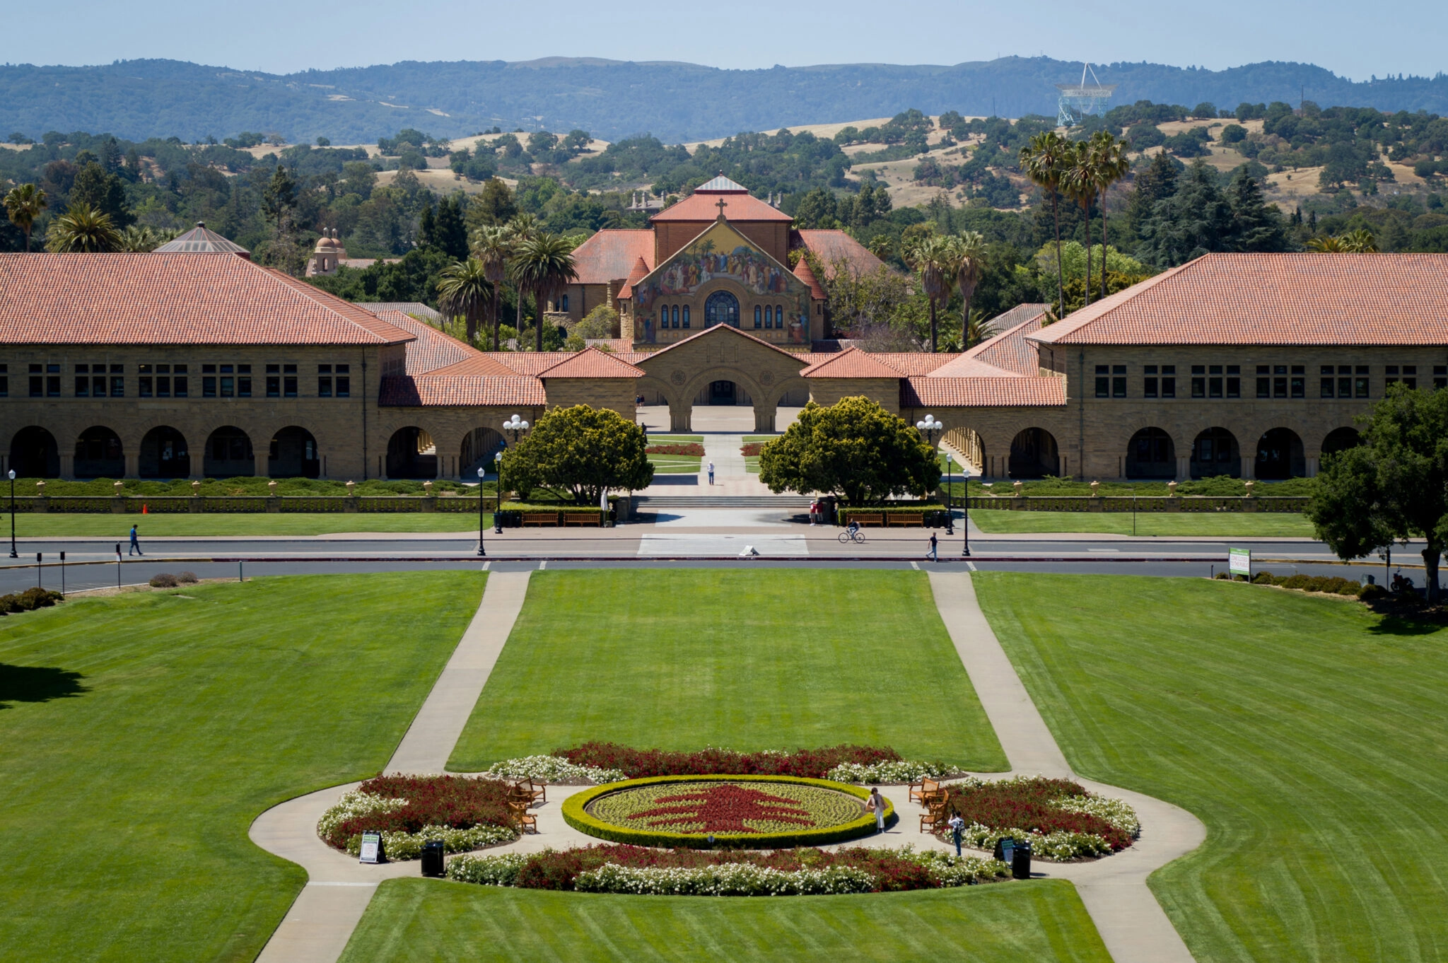

Outstanding Higher
Education
Stanford University
  Accepted by Angela Vincent
Notes:
Outstanding Higher Education
Stanford University
Stanford University is a leading institution in sustainability and waste management education. With programs that address environmental systems engineering, waste reduction, and recycling, Stanford offers students a robust foundation in sustainability. Its career services and applied research centers support student pathways into environmental fields, demonstrating the university’s commitment to developing leaders in recycling and sustainable materials management.

Slide 12
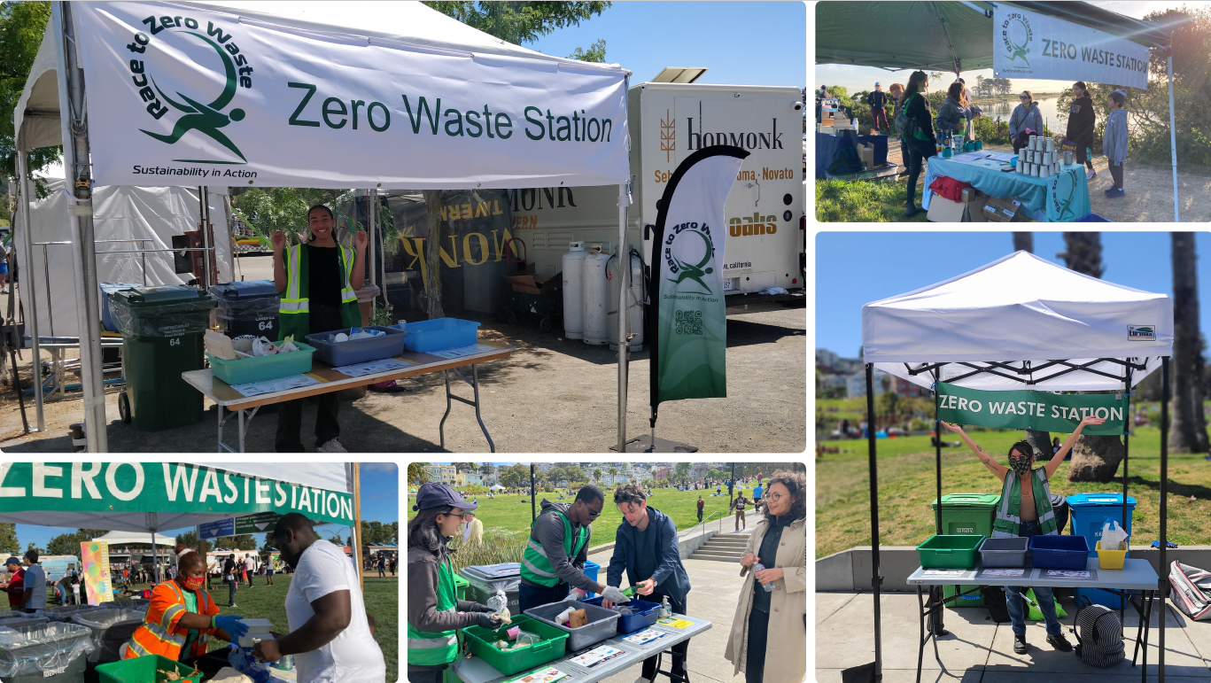

Outstanding
Public Education / Outreach Program
Race to Zero Waste
  Accepted by Teresa Bradley
Notes:
Outstanding Public Education / Outreach Program
Race to Zero Waste accepted by Teresa Bradley
The Love Dolores Project, a collaboration involving Race to Zero Waste and San Francisco’s Recreation and Park Department, showcases the power of grassroots outreach in promoting zero waste. Through hands-on engagement at Dolores Park, the initiative fosters lasting behavioral change, creating a sustainable culture within San Francisco’s public spaces.

Slide 13
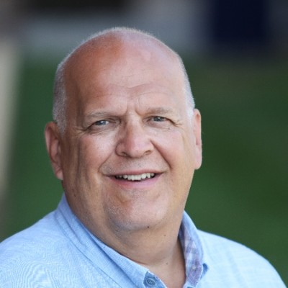
Outstanding Market Development
Wayne Gjerde
Notes:
Outstanding Market Development - Not attending
Wayne Gjerde
As Minnesota's Recycling Market Development Coordinator, Wayne Gjerde has led numerous initiatives to strengthen recycling markets, particularly for glass and other recyclable materials. By establishing the Recycling Market Development Center and fostering partnerships with manufacturers, Gjerde has significantly contributed to the growth of a sustainable recycling infrastructure, helping ensure Minnesota remains a leader in environmentally responsible market practices.

Slide 14
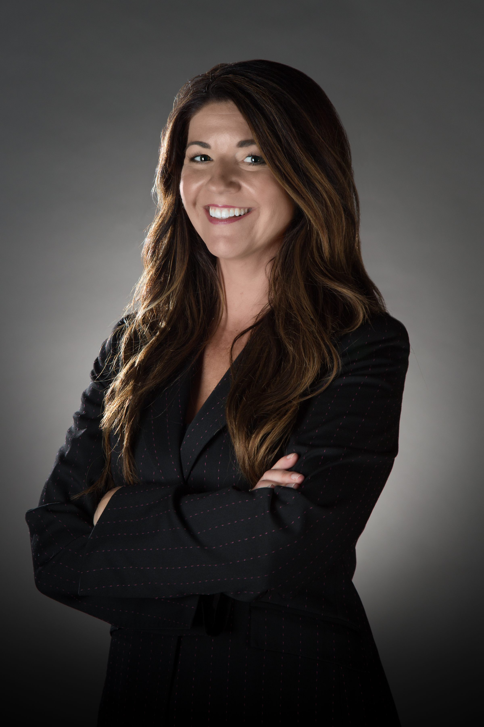

Outstanding Corporate Leadership
Flat Can Recycling
  Accepted by Kathryn Gordon
Notes:
Outstanding Corporate Leadership
Flat Can Recycling accepted by Kathryn Gordon
Kathryn Gordon's leadership at Flat Can Recycling has transformed recycling access in the Midwest, offering convenient, comprehensive recycling options for over 100 specialized items. Flat Can Recycling has quickly become a trusted partner for municipalities, businesses, and communities, delivering impactful solutions that extend beyond traditional recycling services and demonstrate Gordon's vision for a greener future.

Slide 15
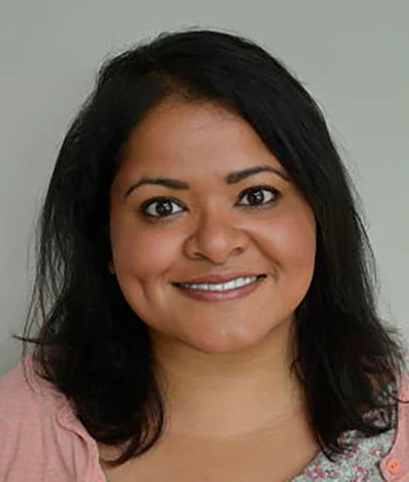
Outstanding Diversity Leadership
Sophia Huda
Notes:
Outstanding Diversity Leadership
Sophia Huda
Sophia Huda is a passionate advocate for recycling, plastic waste reduction, and environmental justice. Her diverse career has spanned continents, from the Middle East to sub-Saharan Africa, and she holds leadership roles in several U.S.-based environmental organizations. With a background in political science and sustainability management, Huda’s global perspective and commitment to environmental equity make her a trailblazer in the field.

Slide 16
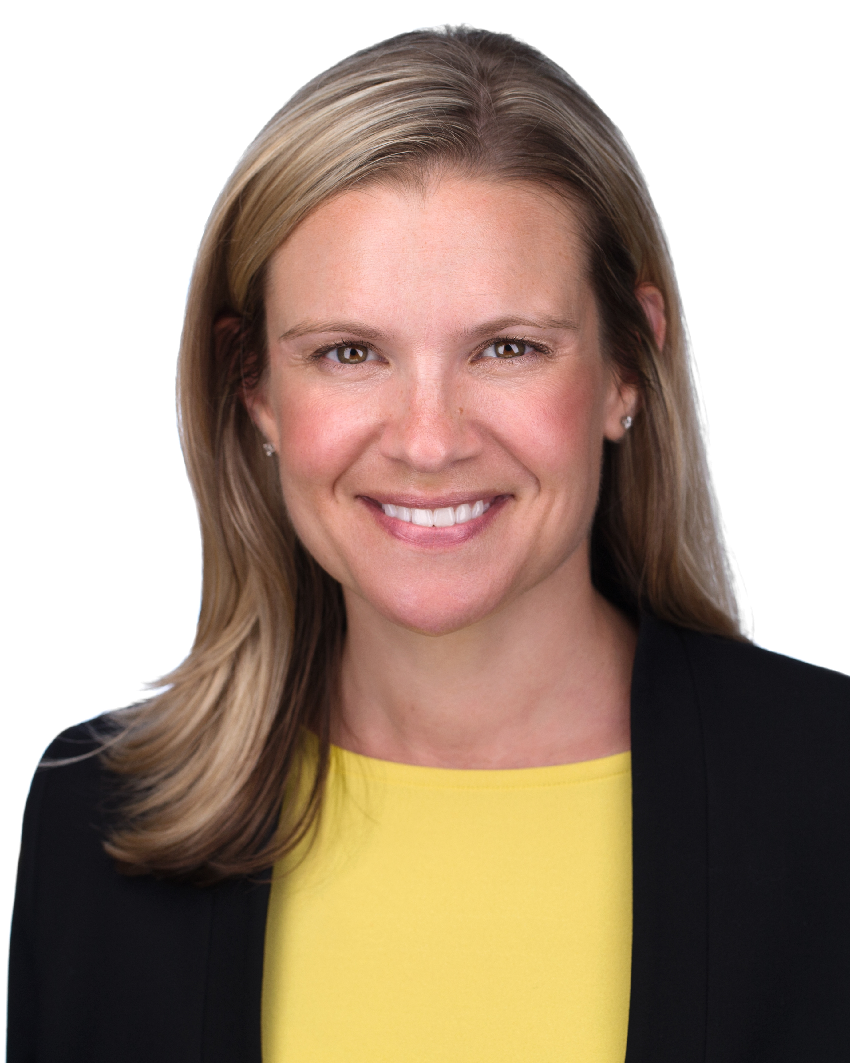

Outstanding Elected
Leader
Mayor Breanna Lungo-Koehn Medford, MA.
Notes:
Outstanding Elected Leader – Not attending
Mayor Breanna Lungo-Koehn, Medford, MA
Mayor Breanna Lungo-Koehn is a strong advocate for Zero Waste in Medford, Massachusetts. Under her leadership, the city launched a phased rollout of residential curbside composting for 19,000 households in July 2024. Mayor Lungo-Koehn has championed the program publicly, producing educational videos and actively supporting community adoption on social media, establishing Medford as a model for waste reduction and sustainability.

Slide 17
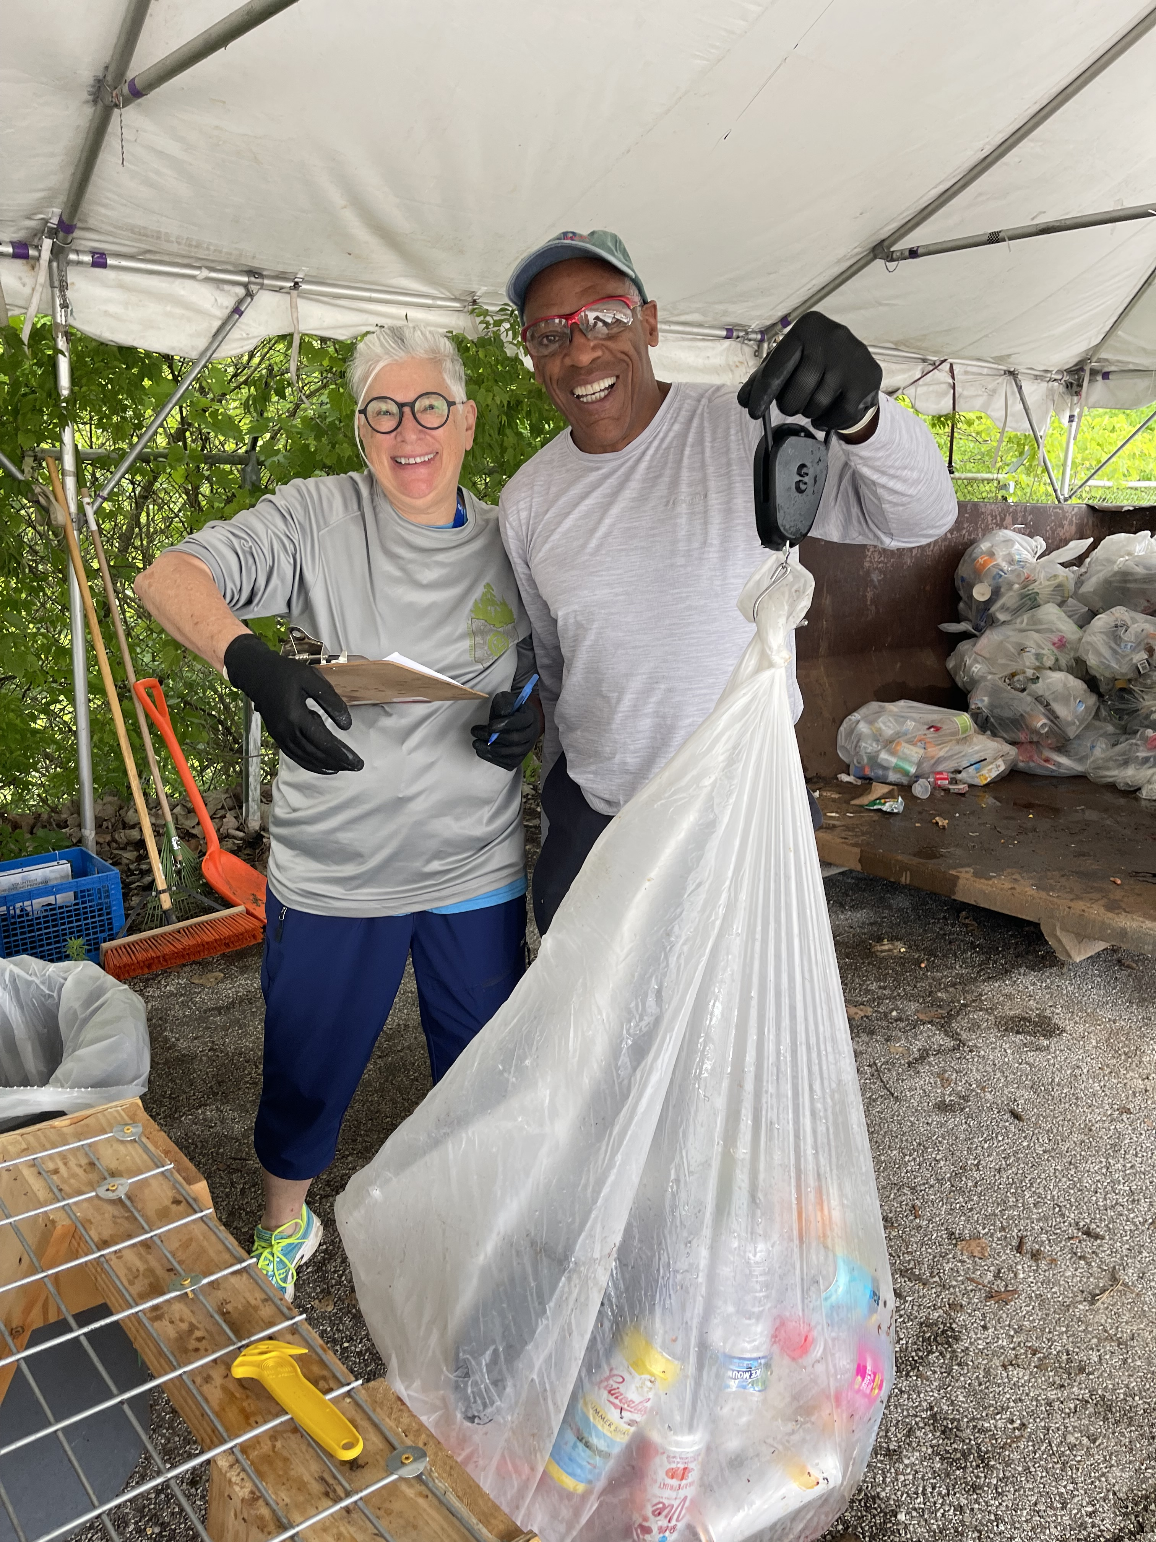
Outstanding Community or Government Program
Cleveland Metroparks Volunteer Recycling Program
  Accepted by Lynne Lisner
Notes:
Outstanding Community or Government Program
Cleveland Metroparks Volunteer Recycling Program accepted by Lynn Lisner
Cleveland Metroparks’ Volunteer Recycling Program exemplifies how community engagement can make a tangible environmental impact. Volunteers have dedicated hundreds of hours to sort recyclables, resulting in 14 tons of recycled material and significant financial savings. The program’s success, grounded in collaboration and education, has become a model for volunteer-led sustainability initiatives that benefit both the environment and the community.

Slide 18
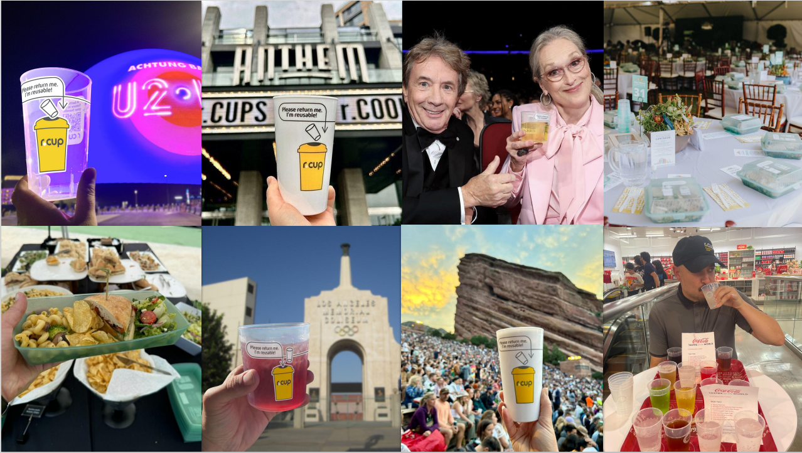

Outstanding Recycling Innovation
r.CUP
Notes:
Outstanding Recycling Innovation – Not attending
r.CUP
RCUP is at the forefront of recycling innovations that prioritize sustainability and waste reduction. By producing cups made from 100% recycled polypropylene and polyethylene terephthalate, r.CUP reduces the need for virgin plastic, cutting down energy usage and carbon emissions. Through their commitment to closed-loop systems and partnerships with recyclers, they promote circular economy principles that contribute to reducing single-use plastic dependence and enhancing recycling infrastructure.

Slide 19
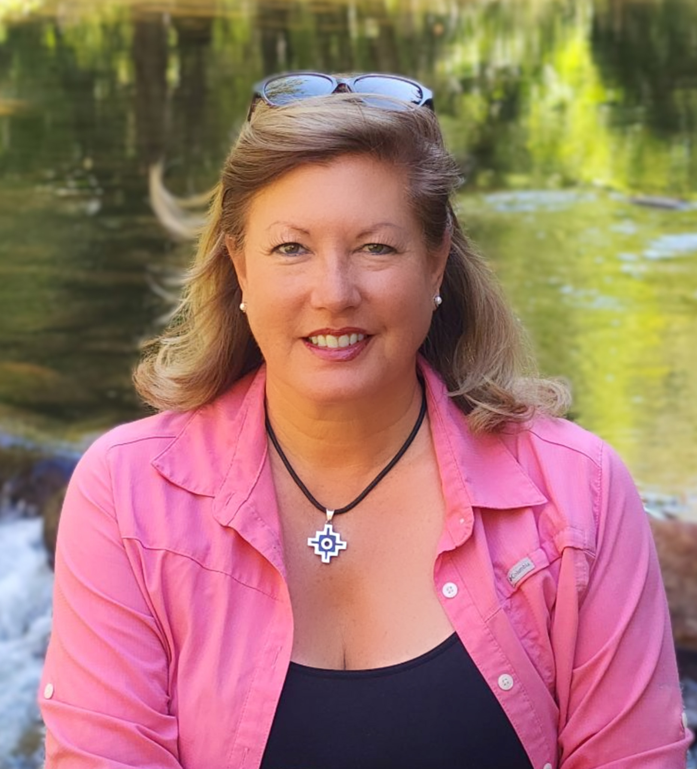
Outstanding
Not-for-profit
Business Leadership
South Bay Sustainable Communities
  Accepted by Tina Matthias
Notes:
Outstanding Not-for-profit Business Leadership
South Bay Sustainable Communities accepted by Tina Matthias
South Bay Sustainable Communities (SBSC) has significantly expanded its composting and community clean-up efforts across fifteen schools in Chula Vista, fostering environmental stewardship among youth. Through hands-on training and peer-led education, SBSC’s initiatives diverted 117,000 pounds from landfills and distributed 4,000 pounds of compost in 2023. Their mentorship program shapes the next generation of environmental leaders, setting a powerful example of community-driven sustainability.

Slide 20
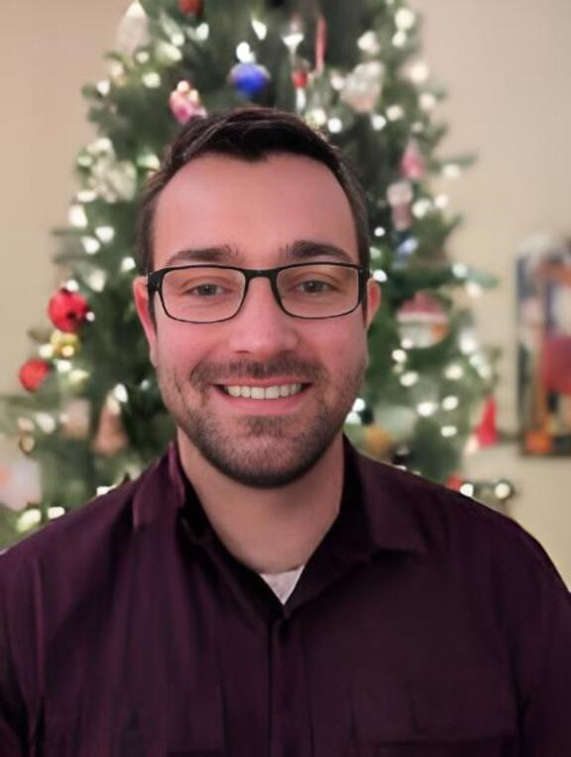
Bill Heenan Emerging
Leader Award
Zach Tucker
Notes:
Bill Heenan Emerging Leader Award – Not attending
Zach Tucker
As part of Colorado's Planet Bluegrass team, Zach Tucker is a young leader shaping sustainable practices at large events in Telluride and Lyons. Starting as a high school volunteer, Tucker has advanced to a pivotal role, championing "sustainable festivation" through innovative approaches that make festivals more environmentally conscious. His dedication to sustainability in the events industry exemplifies the qualities recognized by the National Recycling Coalition's Emerging Leader Award.

Slide 21
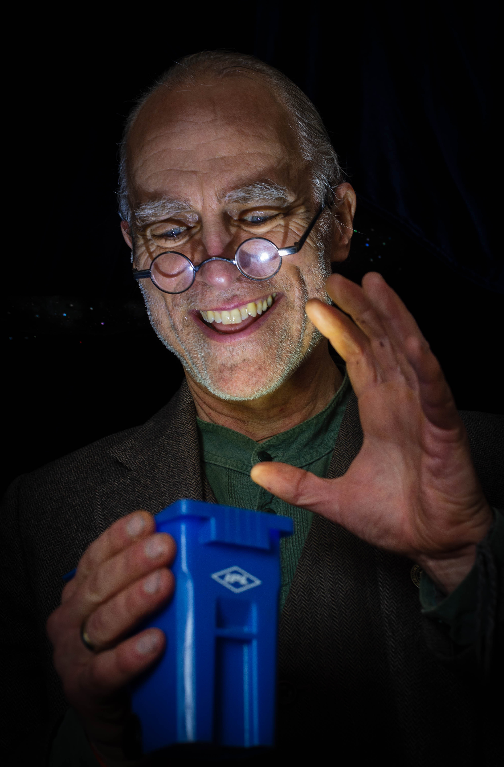
Recycler of the Year
Cyril (CJ) May
Notes:
Recycler of the Year
Cyril May
Cyril May, also known as CJ, brings magic to sustainability education, blending entertainment with environmental advocacy through his “Resourcery” shows, which focus on recycling, water conservation, and sustainability. A Yale Fellow and Environmental Champion Award recipient, CJ delivers TED Talk-style presentations that combine his storytelling craft with years of environmental expertise. His imaginative approach has influenced thousands, extending from professional organizations to schools, as he continues to serve on the Connecticut Recyclers Coalition board and the Connecticut Green LEAF Schools Program’s Steering Committee.

Slide 22
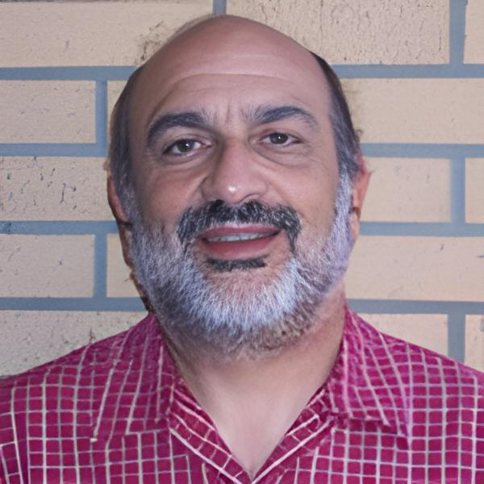
Lifetime Achievement in Recycling
Rick Anthony
Notes:
Lifetime Achievement in Recycling
Rick Anthony
Richard Anthony is a highly respected leader in Zero Waste planning with nearly four decades of expertise in resource conservation and recovery. Previously serving as a solid waste manager for Fresno and San Diego counties in California, Anthony now advises major cities such as Los Angeles and Austin and organizations like the Hawaii Island Economic Development Board. He has been instrumental in advancing Zero Waste practices, contributing significantly to groups such as the California Resource Recovery Association and the Zero Waste International Alliance. Anthony's profound knowledge and dedication to sustainable waste management make him a distinguished and enduring leader in the field.

Slide 23
Thank You & Congratulations to all of this Year’s Winners!

